Slide 1

Setting Up Your Company In China
Richard Hoffmann
Senior Associate
Dezan Shira & Associates

Slide 2
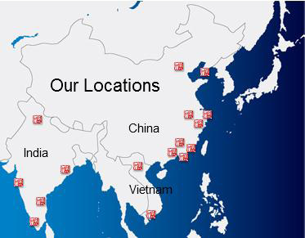
Dezan Shira & Associates – the Asian Practice
18 years in China
10 Offices in China, 5 Offices in India, 2 Offices in Vietnam
2000 clients from 81 countries
Provide buisness incorporation, tax & accounting, legal and HR services

Slide 3

Topics
Legal Structures
Key Advatages / Disadvantages
How to restructure your business when needed

Slide 4
Types Of Legal Structures
- Strategy Must Follow Structure -
Freelancer
Representative Office
Wholly Foreign Owned Enterprise (WFOE)
Foreign Invested Commercial Enterprise (FICE)
Joint Ventures (JV)
Foreign Invested Partnerships (FIP)
Hong Kong Holdings

Slide 5

Types Of Legal Structures
Freelance
Representative Office
Wholly Foreign Owned Enterprise (WFOE)
Foreign Invested
Commercial Enterprise (FICE)
Joint Ventures (JV)
Foreign Invested Partnerships (FIP)
Hong Kong Holdings

Slide 6

“Freelancer”
Is it possible to hire Chinese employees without having a China-based entity?

Slide 7
Representative Office
Typical uses:
Marketing, Research, Liaising
Hiring of employees in China (visa, residence permit, working permit)
Advantage:
Incorporation quick and easy to set up (2-3 months)
Cheap
Disadvantage:
No possibility to issue invoices in RMB (Fapiao)
RO example: Sourcing in China

Slide 8
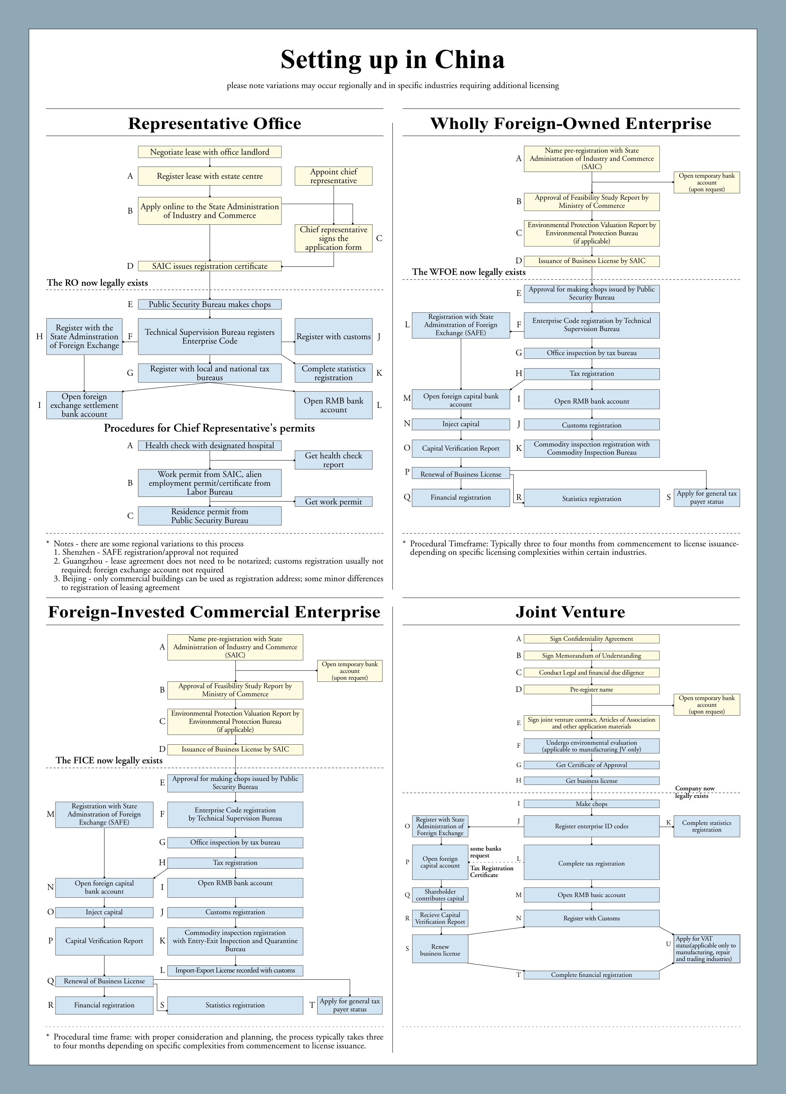

Slide 9

Tax Methods for RO
Cost-Plus- Method (most common for ROs)
  If able to ascertain specific expenses, but not revenue or costs
Actual Revenue Deemed Profit Method
  If able to ascertain revenue, but not costs or expenses
Actual Basis
  File taxes according to actual basis from books and record

Slide 10
Wholly Foreign Owned Enterprise (WFOE)
Typical Use:
Can engage in manufacturing, processing & assembly, services & consulting and/or trade
Advantage:
Direct hiring of employees possible
Can issue invoices in RMB (Fapiao)
Disadvantage:
Application & incorporation procedure: 4-6 months (at least)
Standard Problem: Ratio between Registered Capital and Total Investment
Important: Exit Strategy, Cash Flow

Slide 11


Slide 12
Foreign Invested Commercial Enterprise (FICE)
Typical Use:
Similar to WFOE, but used especially for import, export, distribution and retailing (both wholesale and retail) or representative transactions on the basis of provisions (broker)
Option of franchising
Advantage:
Direct hiring of employees possible
Can issue invoices in RMB (Fapiao)
Disadvantage:
Application & incorporation procedure: 4-6 months (at least)
Standard Problem: Ratio between Registered Capital and Total Investment
Important: Exit Strategy, Cash Flow

Slide 14

Joint Venture (JV)
A Joint Venture in China is an entity involving a Chinese and a foreign party
Cooperative JV (CJV) vs. Equity JV (EJV)
Why do I need a partner?
Risk: Same bed, different dreams!
Restricted market
Other advantages (Network, sales channels, real estate)
Proper evaluation of partner company required
  “Due Diligence”
  Taxes, salary, property rights
  Ongoing/regular review of company finances imperative

Slide 16
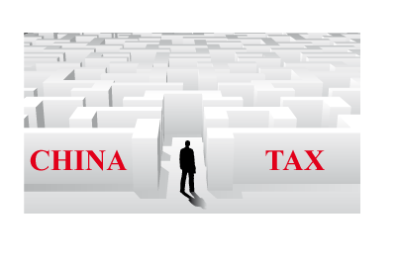
Key taxes for Foreign Invested Enterprises
Business Tax
Value Added Tax
Corporate Income Tax
Dividend Tax
Individual Income Tax

Slide 17

Foreign Invested Partnership (FIP)
  - New Investment Vehicle (“3rd Road to China”)
  - Ideal for High-Tech enterprises
  Advantages:
  Easy incorporation
    Only approval by SAIC and regional authorities, not by MOFCOM
  Flexible Structure
    Management structure defined by partnership agreement
    Dividend distribution
  No minimum registered capital has been set yet
  Registered Capital can be brought in as: Cash (legally obtained RMB or foreign currencies), Land use rights, IP Rights, Technology, Know-How, Service/Labor
  Income Tax Incentives: No Corporate Income Tax for FIP, partners file separate tax returns
  Disadvantages:
  No detailed regulations yet, no approval for Beijing yet
  Uncertainty regarding issues, such as customs, foreign exchange etc.
  Limitations regarding investment (certain industries are prohibited)

Slide 18
Hong Kong Companies
Legal:
Easy and fast to set up
“cheap”
    Set-up costs
    Ongoing compliance
    No “real” office necessary
Tax:
Corporate Income Tax 16.5% (compared with 25% in mainland China)
No VAT (17% in mainland China)
Dividend distribution could be tax efficient
HQ
0%
10%
HK Company
5%
Mainland
WFOE

Slide 19
Restructuring Your Business
Every change is costly and time consuming
Worst – Case: Liquidating your Entity in China
  It is more complicated to liquidate your entity then setting it up
    It helps to have an exit strategy when setting up your entity
    It helps to be in compliance (e.g. taxes!) for liquidating a business
    Calculate severance payment for employees
Best – Case: Need a restructure for growth
  WFOE – Branches
  Representative Office -> WFOE/ FICE
    No “upgrading” possible
    Set up the WFOE/ FICE, then close RO
    Higher costs for having 2 offices for a temporary time
    Potential Tax Benefits

Slide 20

Common Misunderstandings
Restructuring is easy
Funding from overseas – Financial Issues
Labor is “cheap” in China

Slide 21
Financial Issues
Many companies face Cash-Flow issues due to 2 reasons:
Not aware about the legal restrictions for funding of a FDI from overseas
Underestimation of the costs and time needed for being profitable in China

Slide 22
Initial Funding – Registered Capital for a FIE
Minimum Registered Capital for a FIE (WFOE, JV, FICE) ?
The Registered Capital has to come from the Investor – can not be sourced in China
HQ
FIE

Slide 23
Refinancing
Representative Office – no problem
FIE: 3 Options to get capital in:
  1. Increase of the registered capital - but time consuming
  2. Consulting contract with HQ - but taxed
  3. Loan from HQ – but restricted to ratio between registered capital and total investment and only if mentioned in Articles of Association
Loan
Total Invest-ment
Reg. Capital

Slide 24
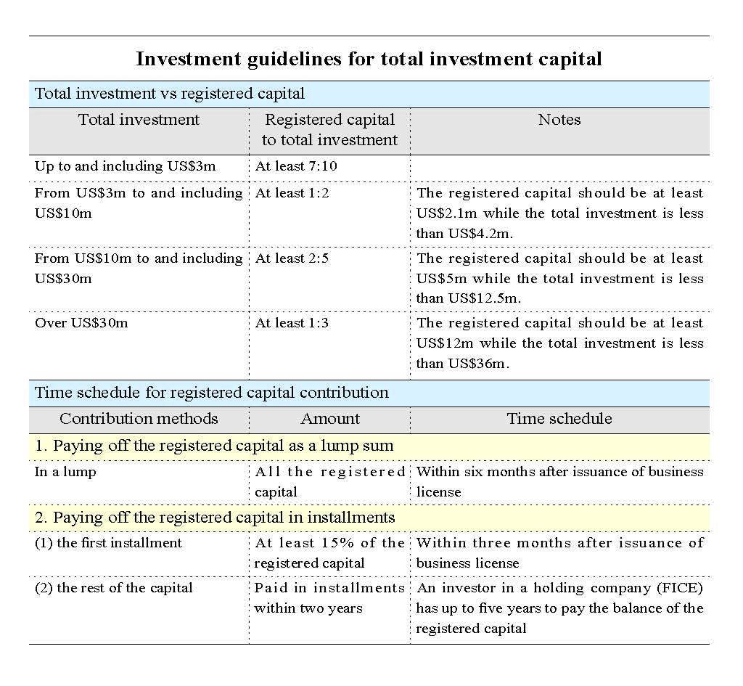

Slide 25
Underestimation of cost and time
Takes time to get business running in China (often 1-2 years)
Ongoing costs like rental and salary
People are not cheap: Salary – and social welfare

Slide 26
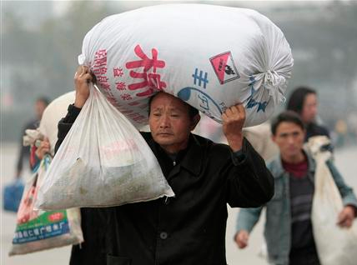
Financial Issue - Salary
  830 million workers in 2010
  Salaries have doubled every 5 years since 1990 – 2010
  70 % of employees are not satisfied with their salary
To keep staff, salary is the key
Dezan Shira
4

Slide 27
Hiring of staff
Large Pool, low hit rate
High HR Turn-Over
CV correct?
Fraud – opportunity + motive + rationalization

Slide 28
Dismissing staff
Labor situation changed since 2008
Written contracts highly recommended
Difficult to terminate labor contracts
Fixed term contracts <-> Open Term Contracts

Slide 29
Fixed-Term Contract
Most common type of contract
Can only be renewed once (Art. 14 III)
  Afterward the employee must receive an open-term contract
If the fixed-term contract is not being renewed severance must be paid – one monthly salary for every year of the labor relationship
Exceptions: The employee refuses to renew a contract, which contains at least the same conditions

Slide 30
Open-Term Contract
What is this?
  A contract, which only ends with the retirement of the employee
Preconditions for such a contract:
  After a one-time renewal of the fixed-term contract , the employee must receive an open-term contract
  An employer has failed to provide a written contract after one year of labor relationship
Problem: Almost impossible to terminate the contract

Slide 31

Over all – A great market

Slide 32
Our experience from dealing with 2000 clients says us:
You need to do…
Due Diligence
Focus on your strategy
Be in compliance with any legal and tax laws
Bring enough money
Be careful
And over all….

Slide 33

be patient

Slide 34

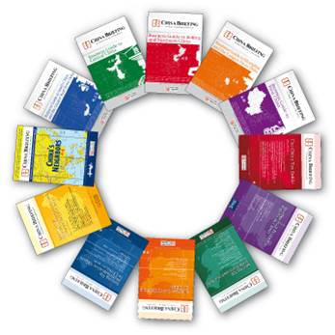

Publications
Magazine
Website
Books

Slide 35
THANK YOU FOR YOUR ATTENTION!
Q&A
Richard.hoffmann@dezshira.com
Mob: +86 18601318781

