Slide 1

An Introduction to Business & Life in China
Manuela Reintgen
Business Development Associate
Dezan Shira & Associates

Slide 2
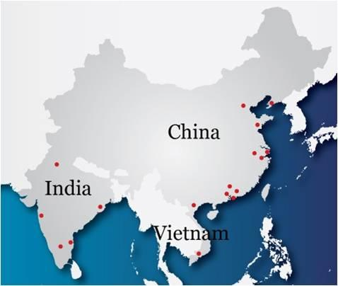
Dezan Shira & Associates
The Asian Practice
19 years in China
12 Offices in China, 5 Offices in India, 2 Offices in Vietnam
2000 clients from 81 countries
Provide business incorporation, tax & accounting, legal and HR services

Slide 3






Our subsidiary Asia Briefing Ltd. has published legal, tax and investment information since 1999 about doing business in China, India, Vietnam, Hong Kong, and Russia.
www.russia-briefing.com

Slide 4


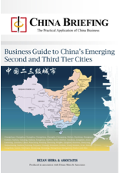
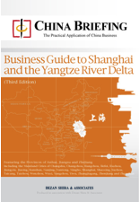
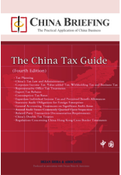
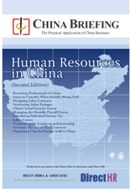
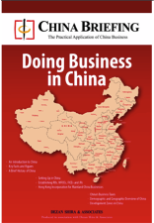

Publications
www.asiabriefingmedia.com
As a premium English language publishing brand in Asia, Asia Briefing’s portfolio includes books, magazines, and news websites.
Apart from our free online resources, we have a wide selection of technical and business guides available through our online bookstore www.asiabriefingmedia.com/store/

Slide 5
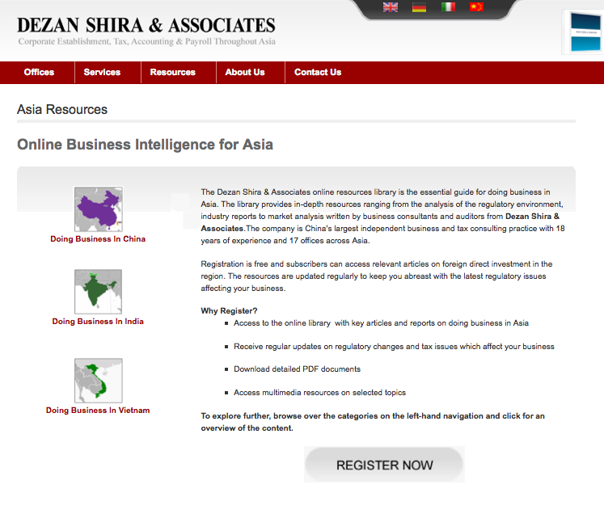
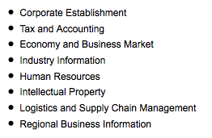
Asia Business Resources Library
www.dezshira.com/asia-resources
The online resources library is the essential guide for doing business in China, India, and Vietnam providing complimentary access to relevant articles and the latest regulatory updates on issues including:

Slide 6
Introduction
With 1.3 billion people, there is no such thing as “one” China market
Treat China as a series of regions all with different cultural and economic norms
Business/work and life in China therefore has many different meanings

Slide 7
Agenda
What you need to know when doing business in China
  Avoiding Cross-Cultural Misunderstandings in Business
  Business Structures
  Challenges in Doing Business in China
Economic, Political and Cultural Overview
  Where is China Today?
The Expat Experience
  How to Get Into China
  Working in China
  Reality of Life in China

Slide 8

Potential Conflict Factors
Time
US/Europe | China
Monochrome time perception | Polychrome time perception
Focus on short-term success “Time is money” | Negotiation as a long-term process Don’t care if they are in time or not

Slide 9
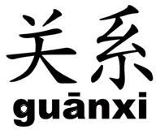
Potential Conflict Factors
Relations
US/Europe | China
“Don’t mix business with private life” | No differentiation between business and private life
Try to focus on business only | Character and personality of business partner really important

Slide 10

Potential Conflict Factors
Dealing with Conflicts
US/Europe | China
“Confrontational” | Want to “ensure Harmony”
Counterpart Reaction: Retraction | Counterpart Reaction: Lack of understanding & Provocation

Slide 11
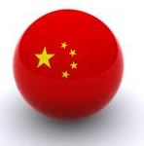
Specific Characteristics
Negotiating with Chinese – the experience
Discussion leader = Leader during negotiations Phenomenon of hierarchy High Power Distance
Strategy without considering the nationality of the opponents
Clear allocation of roles (group leader, observer, “secretary”)
3-steps-strategy: – Observation of counterpart and collection of information – Veiling of own opinion/plan – Evaluation/Adoption of counterparts characters and strategies
Try to communicate on a personal level
Postpone important parts to the end
Interested in long-term (relation)

Slide 12
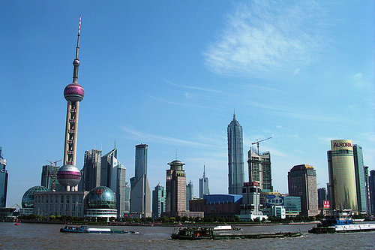
Legal Structuring
Agent/Local Distributor
Freelancer
Representative Office
Joint Venture
Wholly Foreign Owned Enterprise

Slide 13
Representative Office
Typical Uses
Marketing, Research, Liaising
Hiring employees in China (visa, residence permit, working permit)
Example: Sourcing office in China
Advantages:
Incorporation quick and easy to
set up (2-3 months)
Relatively inexpensive
Disadvantages:
No possibility to issue invoices in
RMB (Fapiao)
Common, but not imperative,
monthly payment of 11.56%
business tax on overheads

Slide 14

Joint Venture (JV)
Co-operative JV (CJV) vs. Equity JV (EJV)
A Joint Venture in China is an entity
involving a Chinese and a foreign party
Proper evaluation of partner company
required
Risk:
Same Bed - Different Dreams!

Slide 15
Wholly Foreign Owned Enterprise (WFOE)
Typical Use
Can engage in servicing & consulting,
trading, processing & assembling
and/or
manufacturing
Important: Exit Strategy & Cash Flow Management
Advantage:
100% control over business
Can issue invoices in RMB (Fapiao)
Disadvantage:
Application & incorporation
procedure: 4 -6 months (at least)
Standard problem: Ratio between
registered capital & total investment

Slide 16
Hong Kong Companies
Legal:
Easy and fast to set up
“Cheap”
    Set-up costs
    Ongoing compliance
    No “real” office necessary
Tax:
Corporate Income Tax 16.5%
(compared with 25% in mainland
China)
No VAT (17% in mainland China)
Dividend distribution could be tax
efficient
HQ
0%
10%
HK Company
5%
Mainland
WFOE

Slide 17
Common Challenges Businesses Face
Lack of Due Diligence & Fraud Risk Management
Underestimating Cost and Time
Underestimating the Competition
Labour Issues

Slide 18
Fraud Risk Management
Serious risk lies in mismanagement of fraud which can lead to severe legal implications for a business
Most common reason for JV problems and failures
Keep on top of situations that allow for fraud to take place
  Solid code of conduct
  Strict checks and balances
  Clear paths of responsibility and accountability for management
  Know what’s really going on on the ground
  Disperse “power” – don’t rely on one person to manage business affairs
  Be careful of how legal contracts are drafted
Financial Due Diligence | Individual Due Diligence
Gives a picture of a firm’s performance and financial standing | Gives an idea of an individual’s business/work ethics
Numbers don’t give a good picture of the inner workings | Requires a considerable amount of time to really get to know potential partners

Slide 19
Underestimating Cost and Time
It takes time to get your business running (and profitable) in China (often 1-2 years)
Unaware of the legal restrictions for funding of a FDI
from overseas – cash flow problems
Ongoing costs like rental and salary
People are not cheap: Salary – and social welfare

Slide 20
Underestimating the Competition
Chinese firms are fast becoming more competitive on all levels
Domestic companies are steadily increasing their market share
State backing and “buy local” policies are helping
Perception that Chinese = Low quality has changed both locally and internationally
Improved knowledge and lower production costs mean Chinese products are better adapted to the Chinese market at lower prices

Slide 21
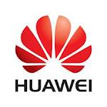
Case Study: Huawei
World’s second-largest telecom hardware maker founded in 1988
Growth from $4,000 startup capital to 2010 revenues of $28 billion
Serves 31 of the top 50 telecom operators like Vodaphone, T-Mobile, Orange and Telefonica
The Future for Huawei
Increase brand recognition
Establish its position in enterprise and consumer markets
Produce “Golden Range” of smartphones ranging between $70 and $200
Produce tablet PCs such as the 4G SpringBoard and MediaPad
Be among top 5 mobile phone makers by 2013

Slide 22
Labour Issues
Issue 1: Salary
Salary is the key to keeping your staff
Cost of labour is increasing rapidly
Minimum wage set to double by
  2015
Issue 2: Labour Contracts
Written contracts are highly
recommended
Difficult to terminate labour contracts
Fixed-term vs. Open-term Contracts
Issue 3: Hiring and retaining staff
Large pool BUT low hit rate
  Increased competition to get the best people
  8 out of the top 10 most attractive employers are Chinese companies
  High labour turnover
  “job hopping” culture
26

Slide 23
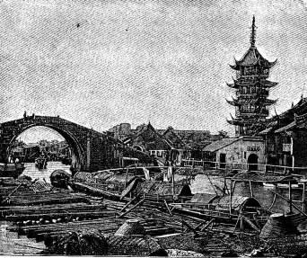


Where is China Today?
1911 1981 2011

Slide 24
Demographics
 |  | Then (1980)…. | …Now (2011)
Population | Total | 990 million | 1 336 billion
 | Poverty Rate | 85% | 15.9%
Transport | Cars | 1.78 million | 100 million
 | Roads | 1 million km | 5.5 million km
 | Railways | 50,000 km | 75,438 km
Construction (urban floor space) |  | 1.378 billion sq/m (approx) | 11.593 billion sq/m (approx)
Technology | Mobile Phone Users | 700 (1987) | 850 million
 | Internet Users | 2,000 (1993) | 457 million

Slide 25
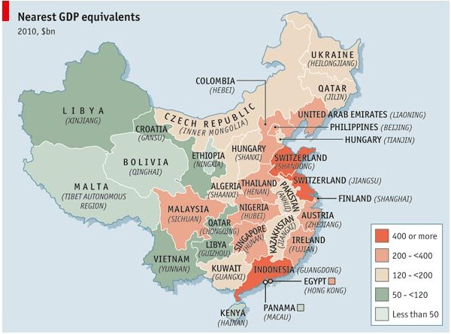
The Economist

Slide 26
…still a long way to go?
Ongoing problems:
Bureaucracy
  Corruption
  Regulatory inefficiencies
Government sensitivity
  Censorship
Lack of innovation
  Copyright infringement
  Imitation rather than invention
Market/industry restrictions
  Protectionism

Slide 27


Case Study: Amadeus IT Group SA
The leading provider of Computerized Reservation Systems (CRS) in the global travel industry
Dominant player in the global travel industry, with revenues of €2.5 billion for 2010
International Global Distribution System (GDS) providers are not allowed to operate their distribution systems in Chinese travel agencies or issue tickets.
This is detrimental to both foreign and Chinese airlines and travel agencies operating in the market and limits the natural development of the travel industry in China

Slide 28

The Expat Experience

Slide 29
Career Prospects
Large job market particularly for highly educated labour – though increasingly competitive
  Hong Kong most attractive
  Beijing, Shanghai and Guangzhou not far behind
  Up and coming: Chongqing, Chengdu and Wuhan
Don’t overlook Chinese companies
Knowledge of Chinese business culture goes a long way
Expand and maintain your “network”

Slide 30

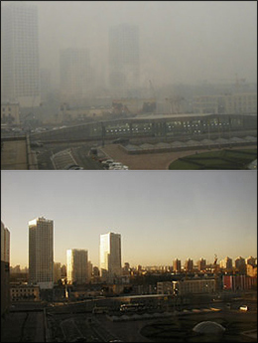
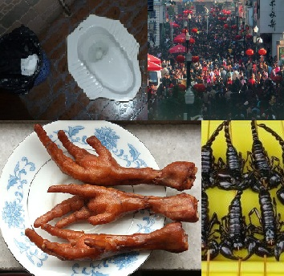
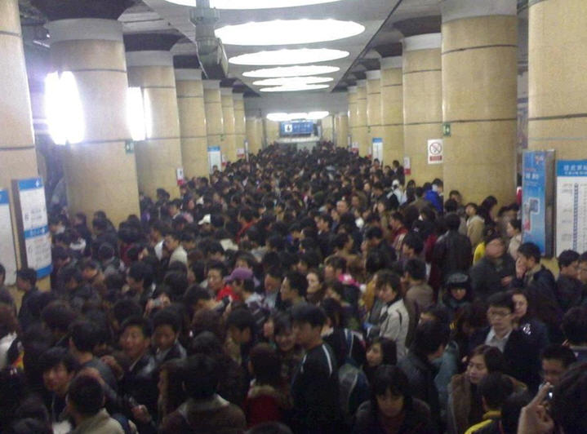
Reality of Life in China - The Bad…
Language Barrier
Pollution
Culture Shock
Overcrowding

Slide 31
Reality of Life in China - The Good…
Large, well-established expat community
  The Beijinger, Agenda, Time Out, China Expat, Chambers of Commerce and Embassies, Inter Nations, book clubs, culture clubs
Cheaper cost of living
Abundance of things to do and see
  Historical monuments and museums, hutongs, parks
  Art galleries/exhibitions, theatres, opera, ballet
  Live music, bars, restaurants, clubs, shopping
Quality of life
  It is becoming increasingly easier to find most things that you can get in the West or reasonably good alternatives
Energetic and fast-paced cities

Slide 32
Thank you for your attention!
Discussion
manuela.reintgen@dezshira.com
Mob: +86 136 9353 4146

