Slide 1
Food and Beverage in Vietnam
Rossella Bizzarri

Slide 2
Dezan Shira & Associates
A pan-Asia specialist FDI and Professional Services firm
1992 Dezan Shira & Associates’ establishment
300+ Our team of legal, tax, accounting, audit, and business intelligence professionals
2,000+ Multinational clients that have already chosen us
80+ Countries served by our professional services
22+ Our offices in China, Hong Kong, India, Vietnam, Singapore, Indonesia; liaison offices in Italy, United States and Germany; and alliance offices in Malaysia, Philippines, and Thailand

Slide 3
We are a one stop shop, offering the following services:
Accounting & Reporting
Pre-Investment/ Market Entry Strategy
Tax Compliance
Corporate Establishment
Payroll & HR Administration
Business Model Comparison
Audit & Financial Review
IT Solutions

Slide 4
Summary
Market Entry Forms
Trading company
Cooperating with Local/Vietnamese partners
Regulations
Importer registration
Caps
EVFTA
Tax duties
Labeling regulations
Labeling regulations
Phytosanitary and Sanitary Issues
Contracts
Advertising and promotion regulation
Facts

Slide 5
Market Entry Forms
Section 1

Slide 6
Trading company
Distribution channels
1 or more retail outlets
Online – E-commerce
License requirements:
IRC - Investment Registration Certificate (Law on Investment No.67/2014/QH13)
Trading License (Decree No.23/2007/ND-CP)
ERC – Enterprise Registration Certificate (Law on Enterprises No.68/2014)
Case 1: With retail establishment | Case 2: Without retail establishment
IRC allows investors to set up 1 retail outlet (Decree No.08/2013/TT-BCT) Multiple retail establishments: Specific license is required (Decree No.08/2013/TT-BCT) | A Specific license from the Ministry of Industry and Trade is required for sales activities via e-commerce platforms (Decree No.52/2013/ND-CP on E-commerce and Decree No.08/2018/ND-CP)

Slide 7
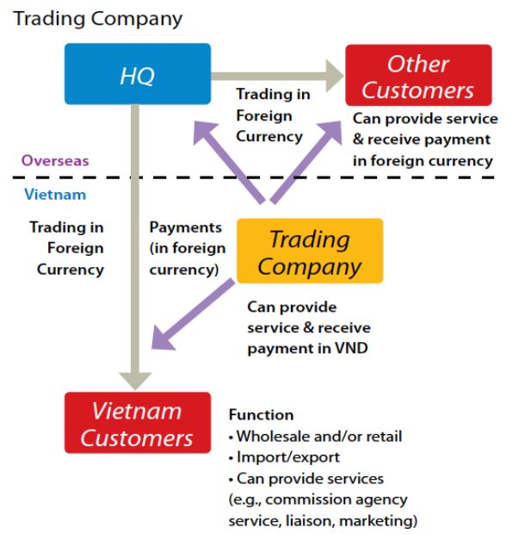
Trading Company
Source: Dezan Shira

Slide 8

Cooperating with Local/Vietnamese partners
Local/Vietnamese partners
Foreign investors can choose to sell and distribute products in Vietnam through a local Vietnamese partner. Potential partners include:
Agents: they sell products on behalf of the foreign investor for a commission. The selling price is set by the foreign investor.
Distributors: they purchase goods from foreign investors for resale. The selling price is set by the distributor.
Importers: most food and beverage importers in Vietnam also act as distributors.

Slide 9

Cooperating with Local/Vietnamese partners
Local/Vietnamese partners
Joint Venture with local Partners
Foreign investors are allowed to have a majority interest under a JV. A JV can be transformed into a WFOE through capital contribution or purchase of shares at a later stage.
The process is regulated under Law on Investment No. 67/2014/QH13

Slide 10
Cooperating with Local/Vietnamese partners
Common distribution channels
Exporters
Local Importers/Distributors
Tradition retail channels (wet markets and small private shops)
Modern retail channels (supermarkets, wholesales stores, convenient stores, minimarts)
Exporters
Local Importers/Distributors
Wholesalers
Traditional and modern retail channels
Exporters
Local Agent
Mordern Retail channels
Exporters
Retail Giants/ Big mordern Retailers (Metro Cash and Carry, Big C, Saigon Co-op, AEON, Lotte, E-mart, Maximart, Citimart, Fivimart)
Source: European Commisson

Slide 11
Trading Company VS Joint Venture
 | Trading Company | JV
Local partners’ network, consumer market and consumer behaviour understanding | No advantage | Full advantage
Restricted sectors for FDI | Limited access to restricted sectors | Access to restricted sectors
Independence | Complete control over the company’s operation | Subject to the percentage of ownership in JV
Setup time | 2-4 months | 2-4 months + private negotiation time
Figure 1: Comparison between Trading company and JV

Slide 12
Regulations
Section 2

Slide 13

Regulations
Importer registration
Local partners/importers must obtain a Food Standards Registration Certificate for each product they import, exception for fresh fruits and meat.
The is valid for 3 years.
If foreign investors don’t have a local partner, they must also obtain a Food Standards Registration Certificate for each product.
Find a distributor that can help with the registration
Notes:
Dossiers required for the application:
A business registration certificate
Import contract
Commercial invoice
Payment document (such as a letter of credit)
Bill of lading of the imported products

Slide 14
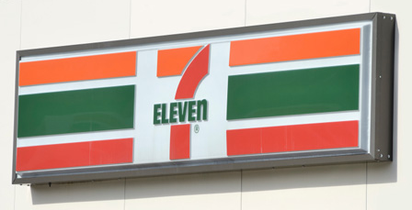
Regulations
Cap on multiple retail establishment
Economic Needs Test (ENT) criteria:
Quantity of retail establishment
Market stability
Residential density
Scale of district-level localities considered for the setting up of retail establishment.
Cap on liquor distribution and wholesaling license
Distribution: 01 License every 400,000 people - National Population Scale
Wholesaling: 01 License every 100,000 people - Provincial Population scale
From 2015 to 2025: cap at 249 Licenses for distribution – cap at 996 Licenses for wholesaling
From 2026 to 2035: cap at 264 Licenses for distribution – cap at 1056 Licenses for wholesaling

Slide 15

Regulations
Phytosanitary and Sanitary
Before customs clearance: inspections for imports of animals, animal products (including dairy products), plants and plant products, and edible fishery products.
If the products are accompanied by Certificate of Free Sale, issued by the exporting countries’ authorities, the inspection process will be faster and cost-saving to the exporting enterprises. (Decision No.10/2010/QD/TTG)
Agricutural products allowed to apply this requirements are listed under Circular No. 63/2010/TT-BNNPTNT issued by the Ministry of Agriculture and Rural Development of Vietnam.

Slide 16

Contracts
Contract language
Unless otherwise specified, enterprises can use bilingual contracts with English as a preferred language.
According to Vietnamese Laws, Stamp/Seal represents the legal position and confirms the legal value of documents of the enterprise.
A valid seal shoud specify the enterprise’s name and ID number.
Stamp/Seal
Notes:
Therefore, to check the seals of the partners, foreign investors can take these steps as follows:
Step 1: Accessing to the National Business Registration Portal: https://bocaodientu.dkkd.gov.vn/inf/default.aspx
Step 2: Using the partner’s ID number to look up for the partner’s bussiness information which also includes the partner’s seal.

Slide 17
Advertising and promotion regulation
Mass advertising
Law on Advertising No.16/2012/QH13
Not permitted to:
  Beverage with alcohol content above 15% (no applicable on beer)
  Substitutes for breast milk - nutritional supplements for infants under 6 months of age.
Common sales promotions such as gift giving, price discount and contest cards are restricted with a 50% restriction on the unit price and 50% restriction on the promotion value
Enterprises can undertake celebration sales or promotion campaigns prior to big public holidays in Vietnam such as Tet or National Day without any value restrictions.
Time period cap on price discount increased from 90 days per year to 120 days per year.
Commercial Promotion Activities – Draft Decree

Slide 18

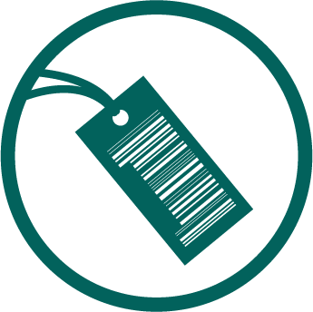
Labeling regulation
Vietnam’s Regulation on Labels and Decree
No. 89/2006/NĐ-CP
Mandatory labeling contents:
  product name
  name and address of individual or organization responsible for the goods
  origin of goods
  other contents depending on nature of products.
Labeling language:
  Additional labels (stickers) including mandatory labeling contents on the commercial package.
  Labeling in Vietnamese and cover all mandatory labeling contents
Goods that are temporarily imported for re-export and re-export after participation in fairs or exhibitions, transited goods are not covered

Slide 19
EU-Vietnam Free Trade Agreement (EVFTA)
Section 3

Slide 20

EU-Vietnam FTA (EVFTA)
Facts
Eliminates 99% of import tariffs within 7-10 years
Partnership and Cooperation Agreement (PCA) governs the overall relationship between the EU and Vietnam
Advantages
EU is the second most important export market for Vietnam
Besides Singapore Vietnam is the only ASEAN country with an EU FTA
Levels playing field between SOE’s and private firms

Slide 21
Tax duties
Value Added Tax (VAT) – 10%: still applicable under EVFTA
Special Consumption Tax (SCT) – only for alcohol products: still applicable under EVFTA
Import tax: substantially reduced or fully liberalized under EVFTA
Tariffs on Imported products:
Import Tax = Import tax rate x import price*
SCT = SCT rate x (Import price* + Import tax)
VAT = VAT rate x (Import price*+ import tax + SCT)
*: Including package value
Tariffs on Inbound manufactured products/local manufactured products:
SCT = SCT rate x Selling price before VAT*
VAT= VAT rate x (Selling price before VAT* + SCT)

Slide 22
Tax duties - SCT
Products |  | Tax rates (%)
Spirit/Wine | a. Spirit/Wine with ABV >= 20⁰
 | - From 1 January 2018 | 65
 | b. Spirit/Wine with ABV <20⁰
 | - From 1 January 2018 | 35
Beer | - From 1 January 2018 | 65
Figure 2: Reference Special Consumption Tax for alcoholic drinks in Vietnam
Note: The Vietnamese Ministry of Finance also expects to apply a 10% of Special Consumption Tax on Soft Drinks from 2019.

Slide 23
Tax duties - Import tax under EVFTA
.
Product | Staging category | Timeframe for liberalization
Wines, spirits, mineral and aerated waters | B7 | 7 years
Beer | B10 | 10 years
Frozen pork meat | B7 | 7 years
Chicken | B10 | 10 years
Fishery products like salmon, halibut, trout, rock lobster | A | At entry into force
Other fisheries | B3 | 3 years
Milk products | B3, B5 | 3 and 5 years
UHT milk | B9 | 9 years
Cheese and butter | B5 | 5 years
Grapes and different styles of berries | B5 | 5 years
Apple and pear | B3 | 3 years
Food preparation | B7 | 7 years
Vietnam’s import tax liberalization for some EU Food and Beverage products
Source: EVFTA

Slide 24
Tax duties - Import tax under EVFTA
alculate tax rate
“A” products: zero import tax rate starting from 2018
“B + number” products: (B3, B5, B7, B9, B10) the number indicates the number of years needed to reach the zero import tax
For example: milk with a tax rate of 15% and categorized as “B3”
15% will be removed in four equal annual stages begining from 2018 => after 2018, the import tax rate imposed on milk will be constantly reduced by an equal amount of 3.75% on an anual basis (15%/4years)
Becomes 0 at year 4th since 2018
 | Base | 1st | 2nd | 3rd | 4th
Year | 2018 | 2019 | 2020 | 2021 | 2022
Tax rate | 15% | 15 – 3.75 = 11.25% | 11.25 – 3.75 = 7.5% | 7.5 – 3.75 = 3.75% | 3.75 – 3.75 = 0%

Slide 25
Tax duties - Import tax under EVFTA
Product category | Base (%) | Year
 |  | 2018 | 2019 | 2020 | 2021 | 2022 | 2023 | 2024 | 2025 | 2026 | 2027 | 2028
Beer (B10) | 35 | 31.8 | 28.6 | 25.5 | 22.3 | 19.1 | 15.9 | 12.7 | 9.5 | 6.4 | 3.2 | 0
Wine (B7) | 50 | 43.8 | 37.5 | 31.3 | 25.0 | 18.8 | 12.5 | 6.3 | 0
Spirits (B7) | 48 | 42.0 | 36.0 | 30.0 | 24.0 | 18.0 | 12.0 | 6.0 | 0
Mineral waters and aerated waters (B7) | 35 | 30.6 | 26.3 | 21.9 | 17.5 | 13.1 | 8.8 | 4.4 | 0
Sparkling mineral waters or aerated waters, flavored (B7) | 35 | 30.6 | 26.3 | 21.9 | 17.5 | 13.1 | 8.8 | 4.4 | 0
Other non-aerated beverages (B7) | 30 | 26.3 | 22.3 | 18.8 | 15.1 | 11.3 | 7.6 | 3.8 | 0
Figure 4: Vietnam’s tariffs schedules on several EU-export products in the Beverage segment

Slide 26
Tax duties - Import tax under EVFTA
Product category | Base (%) | Year
 |  | 2018 | 2019 | 2020 | 2021 | 2022 | 2023 | 2024 | 2025 | 2026 | 2027 | 2028
Milk | 15 | 11.3 | 7.5 | 3.8 | 0
Butter, dairy bread | 15 | 12.5 | 10.0 | 7.5 | 5.0 | 2.5 | 0
Cheese | 10 | 8.3 | 6.7 | 5.0 | 3.3 | 1.7 | 0
Flavored UHT milk drinks | 30 | 26.3 | 22.5 | 18.8 | 15.0 | 11.3 | 7.5 | 3.8 | 0
Pork | 10 | 8.3 | 6.7 | 5.0 | 3.3 | 1.7 | 0
Chicken | 40 | 36.4 | 32.7 | 29.1 | 25.4 | 21.8 | 18.2 | 14.5 | 10.9 | 7.24 | 3.6 | 0
Pure-bred breeding animals | 0
Grapes | 40 | 33.3 | 26.7 | 20.0 | 13.4 | 6.7 | 0
Strawberries, raspberries and other berries | 15 | 12.5 | 10.0 | 7.5 | 5.0 | 2.5 | 0
Apples, pears | 10% | 7.5 | 5.0 | 2.5 | 0
Figure 5: Vietnam’s tariffs schedules on several EU-export products in the Food segment

Slide 27

Labelling regulation under EVFTA
Protocol on Rules of Origin
To obtain preferential treatments in tariffs at Vietnamese border, EU goods exported to Vietnam:
“Originate” in the EU: can be transited through third countries; but not be altered, transformed or subjected to operations other than preserving in good conditions or adding/affixing marks, labels, seals
Be accompanied by a certificate of origin
Origin marking
Exporting countries must obtain the origin marking on their products exported to Vietnam’s market.
Under EVFTA, Vietnam shall accept the marking "Made in EU" or similar markings in other local languages on non-agricultural products (except for pharmaceutical products)

Slide 28
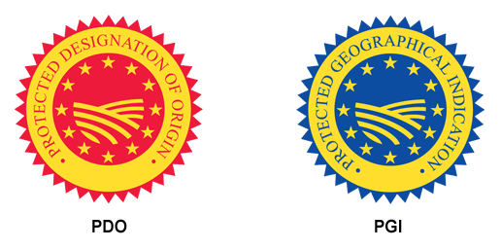
Labelling regulation under EVFTA
GI labelling
Vietnam has set up the GIs registration system that allows foreign investors to apply for Protected Designation of Origin (PDO) and Protected Geographical Indications (PGI) recognition.
Only 2 spirits from the EU, Cognac from France and Scotch whisky from Scotland, are protected under GI mechanism.
EVFTA will provide protection of GIs for 169 EU-made products

Slide 29
Thank you

Slide 30
Our Practice in Vietnam
Hanoi
  hanoi@dezshira.com
  +84 4 3942 0443
  Room 901, Floor 9th, VID Tower 1 Building
  115 Tran Hung Dao Street
  Hoan Kiem District, Hanoi
Ho Chi Minh City
hcmc@dezshira.com
+84 8 3930 2828 or +84 8 3930 2818
3th Floor, Anh Dang Building
215 Nam Ky Khoi Nghia street, District 3
Ho Chi Minh City, Vietnam

