Slide 1
Vietnam Economic Overview
Presented by:
Dustin Daugherty

Slide 2
Dezan Shira & Associates
A pan-Asia specialist FDI and Professional Services firm
1992 Dezan Shira & Associates’ establishment
300+ Our team of legal, tax, accounting, audit, and business intelligence professionals
2,000+ Multinational clients that have already chosen us
80+ Countries served by our professional services
1999 Asia Briefing’s establishment
22+ Our offices in China, Hong Kong, India, Vietnam, Singapore; liaison offices in Italy, United States and Germany; and alliance offices in Indonesia, Malaysia, Philippines, and Thailand

Slide 3
A pan-Asia specialist FDI and Professional Services firm
A specialist practice
Providing FDI services for international businesses looking to enter and expand their operations in Asia
Hold international businesses’ hands through the entire process of pre-establishment and post-establishment
A Pan-Asia practice
Fully-integrated corporate offices working both locally and with one another to provide multi-jurisdictional advice and planning for businesses operating across Asia
Strong interaction among expert staffs through travelling between offices to pool, share, and enhance already extensive regional intelligence on doing business
=> Providing a concise, detailed and accurate picture on the latest developments in the local region, cross-regional tax and regulatory matter

Slide 4
Clients, Alliances, Partners and Associates
Clients
Serving more than 2000 clients from over 100 countries
Clients come from a variety of industries
Clients are mid cap, many are within the Fortune 5000 globally
A diversified clientele allows DSA to strengthen the knowledge base that DSA continues to use in assisting clients do business across Asia
Alliance, Partners and Associations
Alliance: Integra International (a global network of accountants and tax advisors); Leading Edge Alliance (a global network of international accountants and auditors); IR Global (global network of professional services firm)
Partners and Associations: The Dezan Shira Business Partner Program
Providing opportunity for other organizations to work with DSA to improve their visibility and expand their marketing channels
Working closely with various organizations in different industries throughout the globe: ICHAM, U.S. Commercial Service, European Chamber Pearl River Delta, Bloomberg BNA, Financial Times, Canada-ASEAN Business Council, CitiTrust International, Integra International, Australian Business Forum and more.

Slide 5





A subsidiary of Dezan Shira & Associates publishes business magazines and guides for China, India, Vietnam, Singapore and other key nations in emerging Asia
Asia’s largest independent FDI practice provides business intelligence including regulatory updates, analysis and commentary on today’s real issues concerning the foreign investors who are interested and operating in these markets.

Slide 7
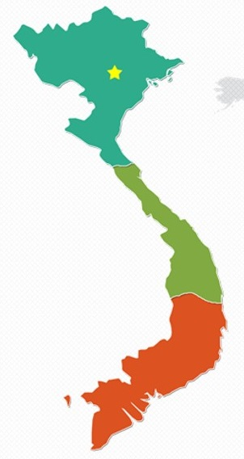
Vietnam
Population: 96 million people (2017), 100 million (2025)
Working-age group: 60% of the population - median age: “30”
The middle and affluent class: 12 million to 33 million (2014 - 2020), one of the fastest growth rates in South East Asia
Three Key Economic Regions: North (Hanoi – the capital),Central (Da Nang – the 3rd largest and seaport city), South (Ho Chi Minh – the largest commercial city)
GDP per capita: US $2,385 (2017), US $3,200 - $3,500 (2020)
Minimum monthly wage: US $121 - $175 (2018)

Slide 8
Wages by region in Vietnam
Region | Minimum Wage per Month (US$)
 | 2018 | Forecast 2019 | Forecast 2020
Region I | $175 | $193 | $207
Region II | $155 | $171 | $183
Region III | $136 | $149 | $160
Region IV | $121 | $132 | $142
Avg. Increase | 6.5% | 9.8% | 7.4%
The minimum wage are based on cost of living and location:
Region 1: Urban Ha Noi and Ho Chi Minh city
Region 2: Rural Ha Noi and Ho Chi Minh city, urban Can Tho, Da Nang and Hai Phong cities
Region 3: Provincial cities and the districts of Bac Ninh, Bac Giang, Hai Duong and Vinh Phuc provinces
Region 4: The remaining localities

Slide 9
Investment Opportunities
GDP growth rate: 6.81% in 2017, the highest rate since 2011
A strong commitment of the government on creating a liberalized business environment: 406 SOEs will be divested over the 2017-2020 period with the estimated total face value divestments of VND 64.46 trillion (US $2.82 billion)
Import-export turnover: US $425.12 billion in 2017, an increase of 21% compared to 2016
Net export: US $2.92 billion in 2017, an increase of 64%
Global manufacturing competitiveness: 18th in 2016, 12th in 2020
Until 2017, 10 FTAs have come into force, EU-VN FTA will be effective in mid-2018, 5 FTAs are under negotiation
FDI: US $35.88 billion, the highest figure since 2007
Global FDI Country Attractiveness Index: 58th in the world, 6th compared to other South East Asian countries and China in 2017

Slide 10
GDP

Slide 11
FDI

Slide 12
FDI
Global FDI Country Attractiveness Index (GFICA Index)

Slide 13
Import and Export

Slide 14
Import and Export

Slide 15
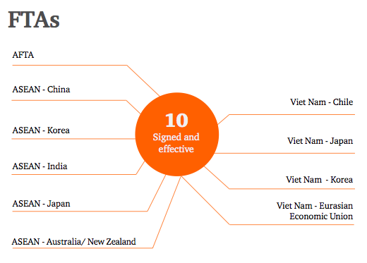
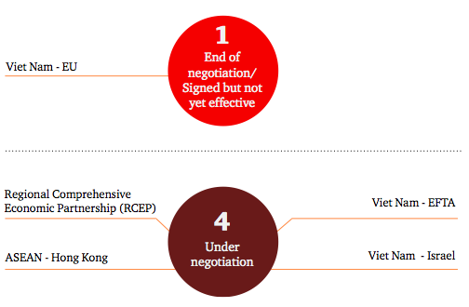
Free Trade Agreement
Source: PwC

Slide 16
Free Trade Agreements – GDP comparison
Country | No. of FTAs * | GDP per capita (PPP)**
US | 15 | US $59,500
Thailand | 23 | US $17,800
China | 24 | US $16,600
Indonesia | 17 | US $12,400
India | 28 | US $7,200
Vietnam | 16 | US $6,900
Cambodia | 8 | US $4,000
* Including signed and effective, under negotiation, signed but not effective
** As per 2017

Slide 17
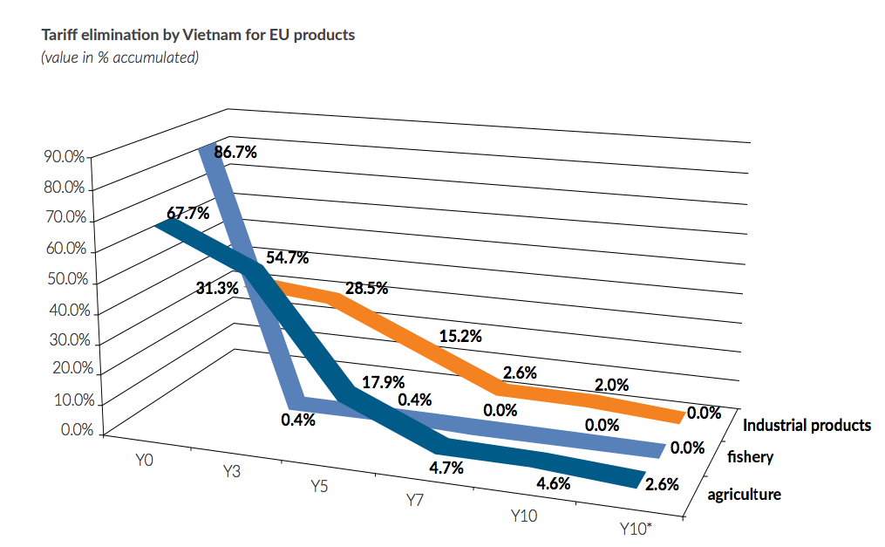
Vietnam – EU FTA (EVFTA)
  Facts: Besides Singapore Vietnam is the only ASEAN country with an EU FTA
  Benefits:
  Liberalizing legal business environment
  Improving transportation infrastructure to facilitate trade and cut costs
  Major beneficiary: Vietnam’s key export industries or labor-intensive industries will expand in terms of capital and employment
  Eliminating 99% of import tariffs within 7-10 years

Slide 18
Global manufacturing competitiveness index
Country | Rank | Index Score
China | 1 | 100
India | 11 | 67.2
Thailand | 14 | 60.4
Malaysia | 17 | 59
Vietnam | 18 | 56.5
Indonesia | 19 | 55.8
Country | Rank | Index Score
China | 2 (▼-1) | 93.5
India | 5 (▲+6) | 77.5
Thailand | 14 | 62
Malaysia | 13 (▲+4) | 62.1
Vietnam | 12 (▲+6) | 65.5
Indonesia | 15 (▲+4) | 61.9
2016
2020 (Projected)

Slide 19
Thank you

