Slide 1
Manufacturing in Vietnam vs Myanmar vs Indonesia
Presented by:
Dustin Daugherty

Slide 2
1. Wages

Slide 3
Wages
 | Myanmar | Vietnam | Indonesia
Current minimum wage | MMK 4,800/day (USD 3.6*) | VND 3,980,000/month (USD 175*) | IDR 3,600,000/month (USD 252*)
Growth (since 2015) | +33% (MMK 3,600/day) | +65% (VND 2,400,000/month) | +33% (IDR 2,700,000/month)
Average wage in manufacturing | MMK 4,800/day (USD 3.6)* | VND 5,463,000/month (USD 240)** | IDR 2,636,846/month (USD 185)**
Social Insurance rate (employer) | 3% | 21.5% | 5.74%
GDP per capita (PPP) 2017 | 6,361 | 6,925 | 12,432
*as of March 1st, 2018
** Dependent on province, can vary significantly
***We believe this figure to be too low, especially for Java

Slide 4
2. Top industries for FDI manufacturing

Slide 5
Top industries for FDI manufacturing – Vietnam
2017: FDI capital inflow highest since 2007, manufacturing / processing attracts most FDI capital: for 44% of the total capital
60% import products and 73% export products from FDI

Slide 6
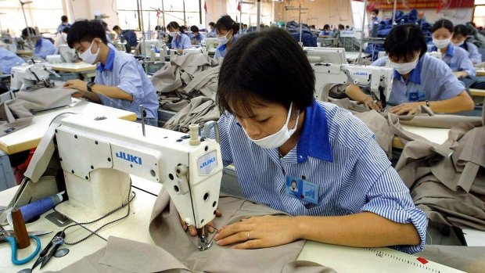
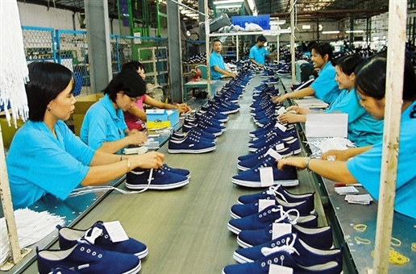
Top industries for FDI manufacturing - Vietnam
Textile and Footwear
Growth rate of 41% in 2020 and the 2nd largest shareholder in the global textile market (World Bank)
85% of companies focus on labor-intensive cutting and sewing
2017: the world’s 2nd footwear exporter
7.3% of the global market share, behind China
Manufacturing hubs
  Southern Vietnam: HCMC, BD, Dong Nai (80% of production)
  Northern Vietnam: Thanh Hoa and Hai Phong
  Central Vietnam: Da Nang and Quang Nam

Slide 7

Top industries for FDI manufacturing - Vietnam
Electronics
2015: Vietnam 12th in the world and 3rd in ASEAN for electronic exporter (CIEM)
2017: electronic exports reached USD 50 billion, 95% of the turnover is contributed by the FDI sector
ASEAN Free Trade Area: lower electronics tariffs
  15% - 20% ➔ 0% - 5%
Consumption increase of electronic products
  7.3 ➔ 11.9% from 2017 to 2020*
*Vietnam Association of Electronics Business

Slide 8
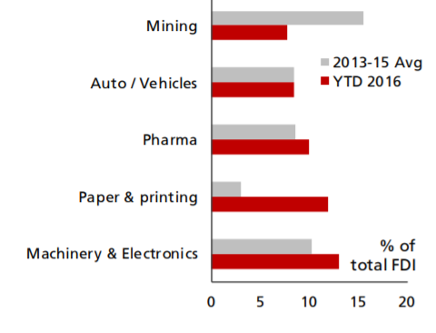
Top industries for FDI manufacturing – Indonesia
Largest GDP in ASEAN
Industrial sector predominant, followed by services
FDI in 2017 reached USD 31.5 billion (+8.5% for 2016)
FDI input in 2017
  Mining
  Auto & Vehicles
  Pharmaceuticals
  Machinery & Electronics
Source: Statista
Source: DBS

Slide 9

Top industries for FDI manufacturing – Indonesia
Auto/Vehicles
2014-2017: 2nd car maker in ASEAN with average contribution of 30% of total cars produced in ASEAN
Huge transition from export country to domestic sales country (for cars)
Car exports estimated to rise between 2020 and 2025
Domestic Car Production | 2014 | 2015 | 2016 | 2017
Thailand | 1,880,007 | 1,913,002 | 1,944,417 | 1,988,823
Indonesia | 1,298,523 | 1,098,780 | 1,177,389 | 1,216,615
Malaysia | 596,418 | 614,664 | 545,253 | 499,639
Vietnam | 121,084 | 171,753 | 236,161 | 195,937
Philippines | 88,845 | 98,768 | 116,868 | 141,252
Myanmar | N/A | N/A | 1,152 | 4,930
ASEAN | 3,984,877 | 3,896,967 | 4,021,240 | 4,047,196
Domestic Car Sales | 2014 | 2015 | 2016 | 2017
Indonesia | 1,208,019 | 1,013,291 | 1,061,735 | 1,079,534
Thailand | 881,832 | 799,632 | 768,788 | 871,650
Malaysia | 666,487 | 666,677 | 580,085 | 576,635
Philippines | 234,747 | 288,609 | 359,572 | 425,673
Vietnam | 133,588 | 209,267 | 270,820 | 250,619
Singapore | 47,443 | 78,609 | 110,455 | 116,148
Brunei | 18,114 | 14,406 | 13,248 | 11,209
Myanmar | N/A | N/A | 4,168 | 8,225
ASEAN | 1,982,211 | 2,057,200 | 2,107,136 | 2,260,159
1 million sold every year
Source: ASEAN Automotive Federation (AAF)

Slide 10
Top industries for FDI manufacturing – Indonesia
Pharmaceuticals
27% of ASEAN market share
Universal Health Coverage Scheme (JKN) promulgated to cover all 260 million people by 2019
JKN will also cover foreigner employees for at least 6 months
2021: pharmaceutical industry expected to reach USD 10.11 billion
Uneven development of the country results in poor equal access to pharmaceutical products
  More room for foreign companies in given areas

Slide 11
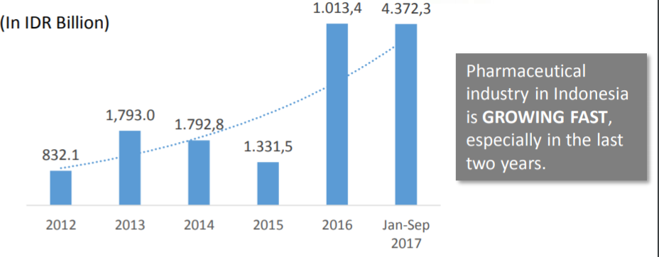
Top industries for FDI manufacturing – Indonesia
Pharmaceuticals
2016: New Negative List
  Increases ownership cap on foreign pharmaceutical companies
Pharmaceutical raw material manufacturer: 100% ownership (85% previously)
  Distributors not affiliated with the production: 67%
  Distributors affiliated with the production: 100%
Hospital owner: 67%
  70% for ASEAN members
Basic and special medical clinics: 67%
  70% for ASEAN members
Source: BKPM

Slide 12
Top industries for FDI manufacturing – Myanmar
Since 2012, trade value between US-Myanmar quadrupled (USD 438 billion)
EU and US allow Myanmar to be eligible for their Generalized System of Preferences (GSP)
  ➔ Reduced tariff rates on exporting products
Biggest advantage
  Lowest minimum wage in ASEAN
2017: New Investment Law – Still not that clear
After 2012, significant FDI increase
  USD 9.5 billion in 2015/2016

Slide 13
Top industries for FDI manufacturing – Myanmar
Garment and Footwear
Garment export
  Target of USD 4 billion by 2020 is possible
2015: garment sector the biggest beneficiary of the EU GSP (62% of exports to the EU)
Industry known for its cut-make-pack (CMP) systems or contracts
  33% exported to Japan
  25% each to the EU and South Korea
  2.4% each to the US and China.
US expected to increase its share in textile exports
  US used to import more than a quarter of Myanmar’s textile exports (before economic sanction)
Source: MGMA

Slide 14
Top industries for FDI manufacturing – Myanmar
Food and Beverage
Population
  53.9 million (urban population rate: 36.8%, young population with a medium age of 27.9)
  Middle class: double by 2020
  75% of workforce work in agriculture
GDP per capita
  2010: USD 1,300
  2030: USD 5,100
Consumer spending (2030): over USD 100 billion/year
Stock supply for retail market: double by 2018
Overall value of packaged food sales and soft drinks sales is growing at a CAGR of 15% and 23% between 2014-2018

Slide 15
3. Top investing countries

Slide 16



Top investing countries – Vietnam
Textile and Footwear
21% of total FDI since joining WTO
2012 – 2016: attracted a capital inflow of USD 5 billion from 26 nations
CPTPP led by Japan expected to sign in March 2018
EVFTA anticipated to come into force mid 2018
228 investment projects: 5 JVs with total registered capital of USD 192 million
  The rest are 100% foreign-owned over 2012-2016
22 projects with registered capital of USD 1.02 billion
Pou Chen Group, building factory in HCMC’s Tan Tao IZ
Sea-A Group committed to invest $2 billion in the industry
Current higher added value chain policies:
Increased outsourcing from China to Vietnam (China +1 Strategy)
Sketchers considering to shift investments from China to Vietnam (investment between USD 700 million and USD 1 billion / workforce of 20,000 people)

Slide 17





Top investing countries – Vietnam
Electronics
Mostly MNCs from
Foreign companies
  80% of local market shares
  90% of total electronic exports
2017:
  Industrial index increased by 9.4%
  Manufacturing and processing index increased by 14.5%
Appearance of big players (Samsung, LG, Microsoft) encouraged presence of electronic parts providers in Vietnam
Largest investors

Slide 18





Top investing countries – Indonesia
Auto/Vehicle
2017: 90% of total car sales
Some firms (Toyota, Nissan) invest heavily for Indonesia to become future production hub
General Motors re-continued production after shutting down years ago
50%+ total domestic car sales (533,903 car units)
MITSUBISHI
Source: Indonesian Automotive Industry Association

Slide 19
Top investing countries – Indonesia
Pharmaceutical
Biggest investors
Japan
Mauritius
Germany
South Korea
Singapore
The International Pharmaceutical Manufacturers Group (IPMG) including 24 MNC members invested more than USD 1 billion
  Focus on factory construction and clinical research
Source: BKPM

Slide 20




Top investing countries – Myanmar
Garment and footwear
2016: Myanmar welcomed 15+ foreign companies, including
Removal of sanctions from EU and US – the two biggest textile importers in the world
  Foreign investors expected to increase significantly, making Myanmar a garment manufacturing hub
Source: MGMA, MMTimes

Slide 21



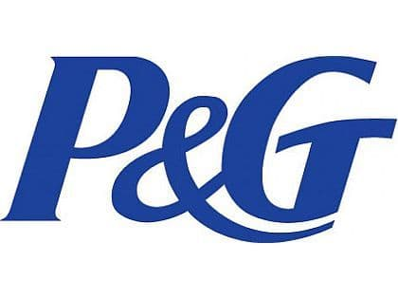


Top investing countries – Myanmar
Food and Beverage
F&B industry has welcomed giant multinational brands, including
Beer sector especially will be highly competitive for market shares
Investment news
  Japan’s Kirin Holdings paid USD 560 million to control Myanmar Brewery Ltd, the largest brewery in the country
  Japan’s Yakult Honsha constructed a manufacturing plant for fermented milk drinks in Thilawa SEZ
  TPG Capital, US private equity giant acquired 50% of total stakes in Myanmar Distillery Company

Slide 22
4. Key Sector Opportunity and Competitive Advantage

Slide 23
Key sector opportunities / competitive advantage for each country
 | Myanmar | Vietnam | Indonesia
Competitive advantage | Large, young & low-cost workforce | Large & English proficient workforce | Largest workforce in the region
 | Highest GDP growth rate | Low-cost & efficient workforce | Highest GDP PPP
 | Abundance of natural resources | Stable economy, government & currency | Growing middle and high income class
 | Location between India & China | Most stable GDP growth rate | Unbalanced development – opportunity for building
Key sector opportunity | Manufacturing | Renewable & clean energies | F&B
 | Telecommunications | F&B, Agriculture (both high and low tech) | Pharmaceutical & Healthcare
 | Oil & Gas | Manufacturing & Processing | Palm oil

Slide 24
5. FTA networks

Slide 25



FTA network – all 3 countries
8 agreements
India CECA*
Japan CEP*
RCEP**
China CECA*
Hong-Kong FTA*,**
Australia/NZ FTA*
Free Trade Area*
*ASEAN agreements
**under negotiation
R.O.K. CECA*

Slide 26
FTA network – Myanmar
Total: 10 agreements
U.S.A. FTA*
Bay of Bengal Initiative for Multi-Sectoral Technical and Economic Cooperation (BIMSTEC) Free Trade Area**
*signed but not yet in effect
**under negotiation

Slide 27
FTA network – Vietnam
Total: 16 agreements
Chile FTA
R.O.K. FTA
Israel FTA**
European Union FTA**
CPTPP*
Eurasian EU FTA
Japan EPA
European Free Trade Association FTA**
*signed but not yet in effect
**under negotiation

Slide 28
FTA network – Indonesia
Total: 17 agreements
Preferential Tariff Arrangement-Group of Eight Developing Countries
Japan EPA
R.O.K. FTA**
Chile FTA**
Australia CEPA**
Trade Preferential System of the Organization of the Islamic Conference*
India CECA**
Pakistan FTA
European Free Trade Association FTA**
*signed but not yet in effect
**under negotiation

Slide 29
Free Trade Agreements – GDP comparison
Country | No. of FTAs * | GDP per capita (PPP)** | Ratio (GDP/FTAs)***
US | 15 | US $59,500 | 3,967
Thailand | 23 | US $17,800 | 774
China | 24 | US $16,600 | 692
Indonesia | 17 | US $12,400 | 729
India**** | 28 | US $7,200 | 257
Vietnam | 16 | US $6,900 | 431
Cambodia | 10 | US $6,400 | 640
* Including signed and effective, under negotiation, signed but not effective
** As per 2017
*** Smaller numbers are better here
**** India is misleading because it has so many “in negotiation” agreements, and generally its FTAs are “lower quality” in that the tariff reductions are less generous, and more products are not liberalized as they are deemed “sensitive”

Slide 30
6. FDI Restrictions

Slide 31

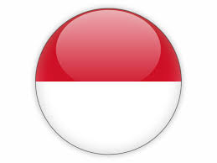
FDI Laws
Foreign Ownership Cap
Law on Investment No.67/2014/QH13 and Decree 118/2015/ND-CP
FDI investments are subject to the list of conditional business sectors and banned business sectors
  Conditional business sectors: conditions of foreign ownership cap, capital requirement and limitation on business activities
  Banned business sectors: prohibited investments
100% foreign ownership allowed for investments in neither list
Current conditional or prohibited sectors:
  rice, frozen foods, alcohol, tobacco and cigarettes, automobile
Still good incentives offered in HCMC/Hanoi/Haiphong area, and great incentives offered in emerging manufacturing provinces like Nghe An
Presidential Regulation No. 44 of 2016 mentioning the latest Negative List of sectors that are either completely closed or partially open to FDI
Sectors are partially open to FDI: a cap on foreign ownership will be set based on sectors and kinds of business
The Negative List helps to create a strong partnership between foreign investors and local companies - local Micro, Small, and Medium Scale Enterprises, and also Cooperatives (“MSMEC”)
Since Negative List 2014, many business lines are now completely liberalized
The New Negative List also allows higher foreign ownership levels for investors from ASEAN member states in relation to certain lines of business
Negative List is still a big problem

Slide 32

FDI Laws
Foreign Ownership Cap
Investment Law 2016 and Investment Rules 2017
FDI in the form of 100% foreign ownership or joint venture is allowed. Sectors open to FDI include manufacturing, services, infrastructure construction, retail and wholesale businesses. Moreover, foreign firms are entitled to a tax holiday in the first three to seven years of operation and other forms of income tax or customs duty reliefs are also available.
If the business is in one of the “Promoted Sectors”, it may be possible to be a 100% foreign-owned business.
If the business is one of the “Prohibited investment activities’, it means:
Investment businesses allowed to be carried out only by the Republic of the Union of Myanmar
Investment businesses not allowed to be carried out by foreign investors
Investment businesses only allowed in the form of a joint venture with a Myanmar citizen or citizen owned entity (a Myanmar local minimum direct shareholding interest of at least 20% however is required with approval from the relevant Ministries)
Most manufacturing sectors are assessed as “Promoted Sectors”, except manufacturing of cigarette, liqueur, beer, and other harmful products to health
Unclear regulations

Slide 33
7. Industrial Zones / Special Economic Zones

Slide 34
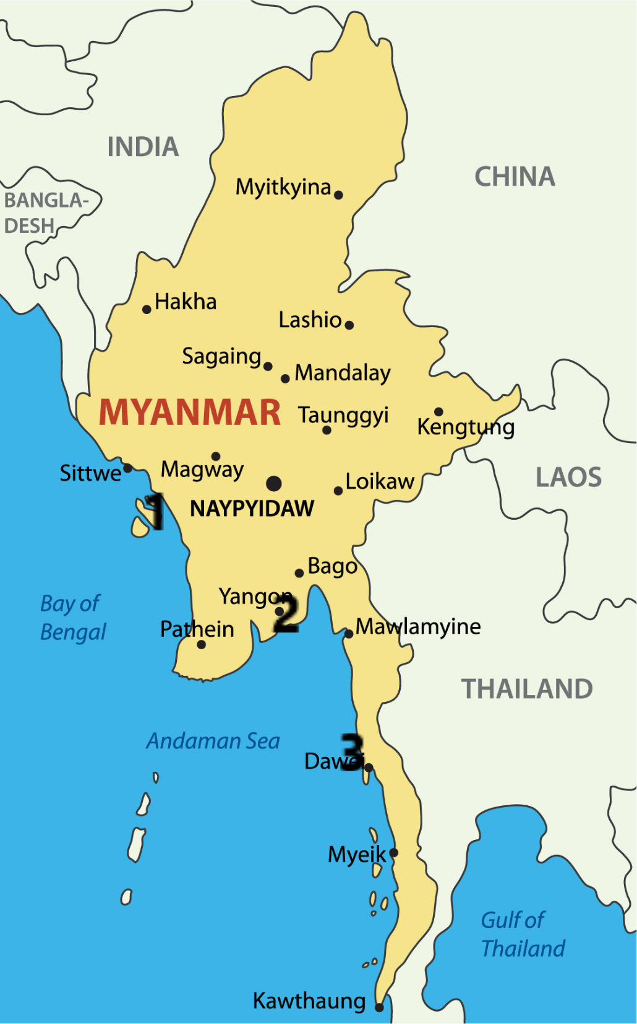
SEZs
Myanmar
  3 SEZs
  Kyaukphyu in Rakhine State
  Thilawa in Yangon Region
  Dawei in Thanintharyi Region
  Incentives
    5 year tax holiday
    50% income tax relief on items exported overseas for 5 years
    50% income tax relief on reinvested profits from overseas exports for 5 years
    5 year exemption on custom duties on approved products
    Granting of 50+25 year land leases

Slide 35
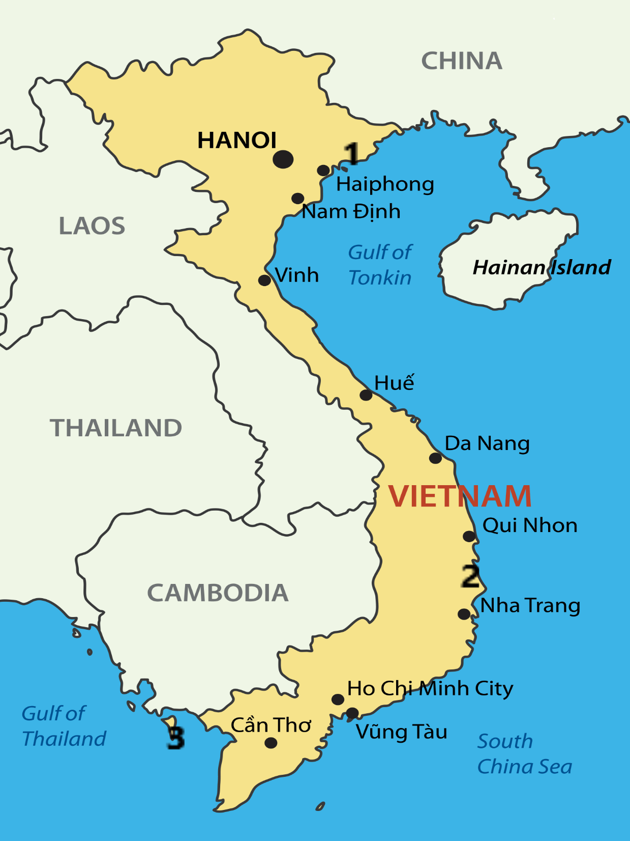
SEZs
Vietnam
  Current 18 EZs
  New 3 SEZs
  Van Don in Northern Region
  Bac Van Phong in Central Region
  Phu Quoc in Southern Region
  Incentives
    Personal income tax exemption for 5 years
    Discount of 50% on personal income tax after the exemption period for a few years
    CIT: 10% tax rate for a 30-year period, a 4-year tax exemption and 50% reduction on payable CIT for next 9 years (specific investments)
    Land use term of 70 or 99 years (specific investment sectors)

Slide 36
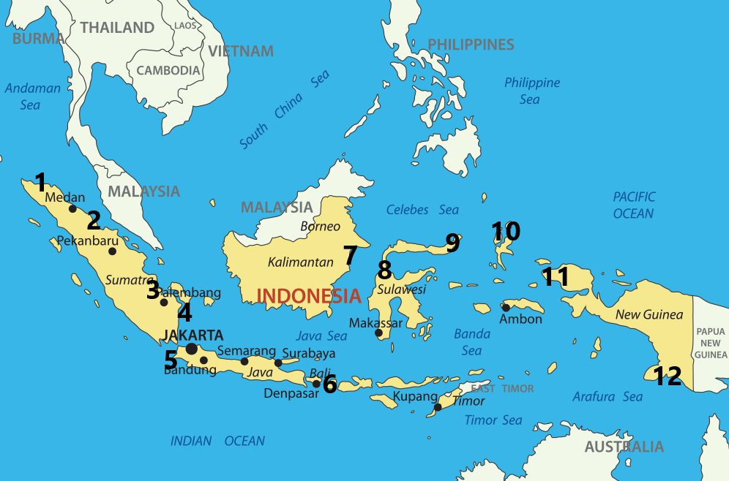
SEZs
Indonesia
  12 SEZs approved
    2 started operations
    2) Sei Mangkei
    5) Tanjung Lesung
    3 to come soon
    6) Mandalika
    7) Maloy Batuta Trans Kalimantan
    8) Palu
  Incentives
  Tax holiday of between 20 and 100% for up to 25 years (Economic Policy Package No.6)
      Investment worth IDR 500 billion: up to 15 years
      Investment worth IDR 1 trillion: up to 25 years
  VAT exemptions on raw material import
  VAT exemption on manufactured goods sold within Indonesia
  Easier land acquisition for up to 30 years (10 year extension)

Slide 37
Industrial Zones
Vietnam 325 / 220 in operation
  A lot of them and they vary a lot from international quality to very local
Indonesia 73
  Across 20 regions, but mostly in Java
Myanmar 28 / 20 in operation
  North Yangon and East Yangon are the largest, some regions have none
Incentives
  Available land and infrastructure
  Proximity to business centers
  Preferential tax rates, land rates etc.
  More support from management board when compared with SEZ, as in SEZ you often have to deal directly with DPI, other ministries for licenses

Slide 38
IZ/SEZs
 | Myanmar | Vietnam | Indonesia
Pros | Mostly located near the business centers, Yangon area (IZs) | Highest number of choice between IZs and SEZs | Highest number of planned SEZs (25 by 2019)
 | Incentives in SEZs are particularly interesting compared to IZs | Each 4 region has specificity for FDIs (SEZs) | Great incentive for heavy investments (IDR 1 trillion: USD 72 million) (SEZs)
Cons | Development slower than anticipated (SEZs) | Previous SEZs did not fully satisfy foreign investors | Distance from economic center (Java) to develop more rural areas
 | General development of the country threatens long term investments | IZ due diligence is time consuming | Basic infrastructure and skilled labor harder to find

Slide 39
Myanmar vs Vietnam vs Indonesia – Assessment
 | Myanmar | Vietnam | Indonesia
Wages | Very low | Medium | High
Key sector opportunities | Low-added value, raw materials | Mid-added value and export | Higher-added value and consumer
Competitive advantage | Lowest cost | Great quality/cost ratio | Largest consumer market in development
Infrastructures | Poor | Improving | Improving
Ease of doing business | Difficult | Easy | Difficult
Skilled/English proficient workforce | Poor | Good | Good
IZs/SEZs | Poor | Good | Developing
Overall | Low-cost but very uncertain, political direction dangerous, rule of law inadequate | Good quality, cost and easy to do business, currently in “sweet spot” for growth | Higher-costs, uneven development but good potential – important local market

Slide 40
Our Practice in Vietnam
Hanoi
  hanoi@dezshira.com
  +84 4 3942 0443
  Room 901, Floor 9th, VID Tower 1 Building
  115 Tran Hung Dao Street
  Hoan Kiem District, Hanoi
Ho Chi Minh City
hcmc@dezshira.com
+84 8 6299 8294
3rd Floor, Anh Dang Bldng,
215 Nam Ky Khoi Nghia Str
District 3, HCMC

