Slide 1
Hiring and Recruitment Methodologies and Issues
Risks and Compliance Strategies
Cherry Wu
HR Manager
Valeria Manunza
Assistant Manager
March 28th, 2019

Slide 2

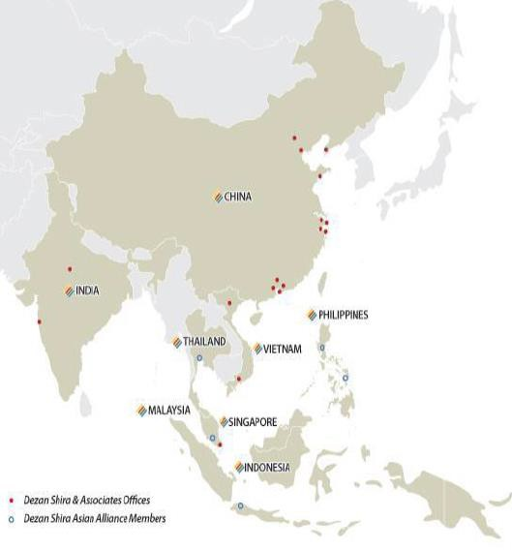
1992
Dezan Shira & Associates
establishment
300+
Our team of legal, tax, accounting and audit professionals
2,000+
Multinational clients that have already chosen us
80+
Countries served by our professional services
24
Our offices in China, India, Vietnam, Singapore, liaison offices in Italy, the United States and Germany, and alliance offices in Indonesia, Malaysia, the Philippines, and Thailand.

Slide 3



Business Intelligence
Pre-Investment and Entry Strategy Advisory
Accounting & Bookkeeping
Treasury Management
Corporate Tax Structuring &
Compliance
Transfer Pricing
Individual Income Tax
Corporate Establishment and Structuring
Audit
Financial Review
Risk Advisory and Fraud Investigation
Due Diligence
HR Administration
Payroll Service
Recruitment Assistance
Information Systems & ERP
Cloud-based Solutions
IT Infrastructure Engineering and
Consulting
Cross-border Transactional
Support
www.dezshira.com
3

Slide 4
www.dezshira.com
4

Slide 5


Valeria Manunza currently works as Assistant Manager at Dezan Shira & Associates, leading the team of South China International Business Advisory providing support to foreign investors aiming at Asia and assistance about legal and management issues affecting foreign Invested Enterprises in China.
Valeria is an Italian lawyer, having obtained a master degree cum laude in Law at the University of Milan in 2011 and was admitted to the Milan Bar in October 2014.
Valeria also performs the role of Chair for the Small and Medium-sized Enterprise South of China Working Group of the European Chamber of Commerce in China and Vice Coordinator of the Intellectual Property Working Group of the Italian Chamber of Commerce in China.
Speakers(Introduction)
Cherry Wu currently works as a manager in the HR & Payroll services team of Dezan Shira & Associates' Shenzhen office. She joined Dezan Shira & Associates as the Manager of HR & Payroll in August 2016.
Cherry holds a bachelor’s degree major in English from Hunan Institute of Science and Technology.
Before joining Dezan Shira & Associates, Cherry worked in several multi-national enterprises where she developed an extensive skillset in human resource management, compensation and benefit (C&B), recruitment, organization development (OD), employee relationship (ER) management.
Cherry is specialized in the fields of payroll, labor law, recruiting, hiring pattern.
www.dezshira.com
5

Slide 6
Table of Contents
Section 1:
The Reasons Behind Labor Disputes
Section 2:
Drafting Employment Contracts
Section 3:
Designing the Staff Handbook
Section 4:
Tips for Termination and Severance Pay
Section 5:
Risk during Hiring and Recruitment

Slide 7
The Reasons Behind Labor Disputes

Slide 8
A Rise in the Incidence of Disputes
Labor Disputes in China
Number of labor disputes in China from 2011 to 2016 (in millions)
Trial Result for Labor Disputes in 2017
Number of cases employees won
2011
0.59
Employees as Plaintiff
76%
2012 |  | 0.64
2013 |  | 0.67
2014 |  | 0.72
2015 |  |  |  | 0.81
2016 |  |  |  | 0.83
Employees as Defendant
65%
Processing Time for Labor Disputes
Average | Min. | Median | Max.
96 days | 1 day | 74 days | 3830 days
Number of labor disputes increased dramatically in China from 2011 to 2016.
Chinese employees are increasingly aware of their rights, disgruntled employees are litigious and increasingly take
legal action (or threaten to do so).
For employer, labor disputes are the waste of manpower, material, financial resources, energy.
The whole process and result of labor disputes may hugely influence the current or future HR management within the
company.
Source: https://www.statista.com/chart/10443/china-labor-disputes-on-the-rise/
http://www.stats.gov.cn/tjsj/ndsj/2017/indexeh.htm http://www.360doc.com/content/18/0308/10/32260249_735323479.shtml#
www.dezshira.com
8

Slide 9
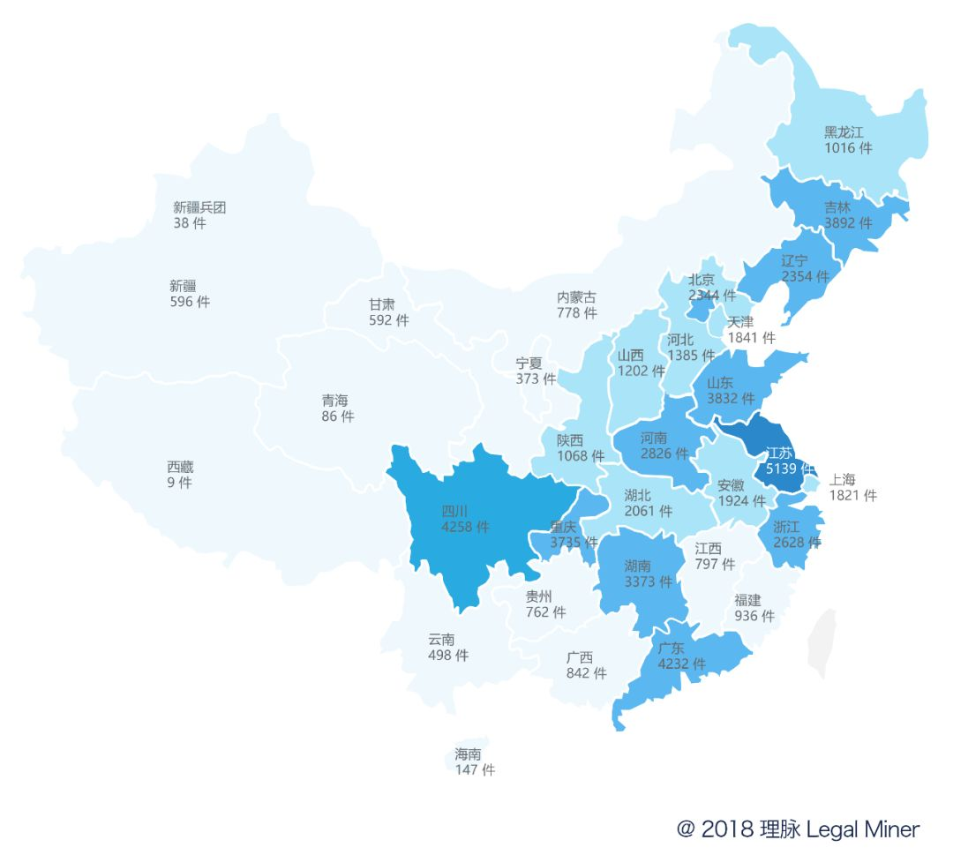
Regional Distribution of Disputes
(excluding Hong Kong, Macao and Taiwan)
7 provinces had more than 3,000 labor disputes cases in the whole year: Jiangsu, Sichuan, Guangdong, Jilin, Shandong, Chongqing and Hunan.
Provinces of Guangxi, Jilin and Shandong have the highest employee’s success rate, exceeding 80%.
Provinces Of Shanghai, Xinjiang and Hunan have the lowest employee’s success rate, which is below 65%.
Guangdong
Number of cases | 4,232
Employee’s wins | 2,967
Employee’s rate of success | 70%
Source: http://www.360doc.com/content/18/0308/10/32260249_735323479.shtml#

Slide 10
Industry
Industry | Employees’ rate of success
Technology | 80%
Wholesale and retail | 81%
IT | 74%
Manufacture | 72%
Environment | 63%
Power, heat, gas and water production and supply | 50%
Finance | 29%
The industry has a great impact on the outcome of labor disputes. The gap in employee success rate in labor disputes in different industries can reach up to 56%.
The probability of employees winning the case in labor disputes in wholesale and retail industries and the technology industry, is higher than 80%.
In the power, heat, gas and water production and supply industries and the financial industry, employees’ wins are generally equal to or less than 50%.
Source: http://www.360doc.com/content/18/0308/10/32260249_735323479.shtml#

Slide 11
Causes for Dispute
Cases handled by Labor Arbitrators (2014 ~ 2016)
13.54%
5.13%
1. Labor Remuneration
2. Social insurnace
7.9%
3. Working hours
49.93%
Labor contract signing
Severance pay
11.7%
6. Others
11.8%
Source: http://www.360doc.com/content/17/0503/08/1113159_650511372.shtml

Slide 12
Occurrence time of Disputes
The risks for the employer is usually while or after the termination
19.27%
1. While or after terminating
49.93%
2. On job
3. Without labor contract but have
actual employement relationship
30.8%
Source: http://www.360doc.com/content/17/0503/08/1113159_650511372.shtml

Slide 13
Social Security-related Cases
Success rate
66%
82%
73%
Labor disputes related to social insurance has the highest success rate of employees, which was 82%.
The court has the strongest support for social security-related labor disputes.
Source: http://www.360doc.com/content/18/0308/10/32260249_735323479.shtml#

Slide 14
Drafting Employment Contracts

Slide 15
Employment Contract (Introduction)
Three Types of Employment Contracts
  Fixed term contract
  Non-fixed term contract
    After 2nd fixed term contract or 10 years of employment employee is legally entitled to an open term contract
    Not applicable to foreign employees who can only work on fixed-term contracts
  Labor contract which expires upon completion of certain agreed assignments
Timing of Employment Contract Signing
  Must be signed within one month of commencement of labor relationship
  Penalties
    Double salary from 2nd month to 12th month (or until contract is signed prior to 12th month)
    Open term contract after 12th month
Language
  Employment Contract should be in Chinese or bilingual (with Chinese included)

Slide 16
Employment Contract (Content & Clauses in Article 17, Labor Contract Law of the PRC)
Mandatory Clauses
  Name and address of the employer and the legal representative or key person-in-charge of the employer;
  Name, address and identity card number or other valid identity document number of the worker;
  Term of labor contract;
  Job duties and work premises;
  Working hours and rest periods and off days;
  Labor remuneration;
  Social security;
  Labor protection, working conditions and occupational hazard prevention and protection;
  Any other matters to be included in a labor contract as stipulated by the laws and regulations.
Additional Optional Clauses
  Probation period
  Training
  Confidentiality
  Supplementary insurance
  Welfare and incentives
  Others

Slide 17
Probation Period
Applicable Probation Periods
Employer’s Rights & Obligations
  The wage amount of a worker during his/her probationary period shall not be less than the lowest wage amount for the same job position in the employer's organization or 80% of the wage amount agreed in the labor contract and shall not be less than the minimum wage standard of the locality of the employer;
  Company can terminate employee during the probation period (with proof employee does not meet job requirements);
  The same employer (legal entity) and the same worker may only agree on probationary period once.
Employee’s Rights & Obligations
  Employee is entitled with the social insurance, housing fund and statutory annual leave during the probation period;
  Employee can resign by giving 3 days prior notice to employer.
Contract Term | Maximum Probation Period
Less than 3 months | None
3 months ~ less than 1 year | 1 month
1 year ~ less than 3 years | 2 months
≥ 3 years or non-fixed term contract | 6 months

Slide 18
Overtime (OT) Compensation
OT Defined Under Standard Work Hour System
  Work will be considered as overtime if company requests employee(s) to work during time in addition to 40 hours per week
  Employer must arrange alternative leave for employees or pay the OT compensation for employees extra working hours.
  The OT hours for one employee per month shall be no more than 36 hours.
OT Compensation Under Standard Work Hour System
Time of Work | Percentage of Hourly Salary
Extra Hours Worked on Weekdays | 150%
Hours Worked on Weekends | 200%
Hours Worked on Holidays | 300%
OT compensation calculation tips:
Based on the hourly salary of the employees
Daily salary: monthly salary ÷ 21.75
Hourly salary: monthly salary ÷ 21.75 ÷ 8

Slide 19
Amendments (Labor Contract)
Salary Increase
  Theoretically, for all kinds of amendments of the labor contract content, the employer should sign an official agreement with the employees;
  Practically, as salary increase is a benefit for the employee, the employer may choose not to sign the agreement with the employee but instead of registering the changes on a internal form or sending a notice letter.
Salary Decrease
  To protect the company’s interest, we highly suggest the employer to sign an official agreement with the employee for any salary decrease decisions with mutual agreement with employee;
Job Transfer
  As change the job position is the change of the labor contract content, signing an official agreement to with employees to demonstrate the fact is also recommended;
Renewal of Employment Contract
  Company should ask the employee to sign the renewed Employment Contract.

Slide 20
Designing the
Staff Handbook

Slide 21
Staff Handbook (Content & Clauses)
Common Issues Detailed in Staff Handbook
  Company code of conduct
  All internal rules, guidelines and the rights of both parties
  Relevant Key Performance Indicators (KPIs), performance standards and assessment information
  Nondisclosure agreement
  Information about work environment
  Work hours and overtime rules
  Remuneration rules, social welfare rules, and bonuses
  Information about paid leave
  Behavior standards and discipline procedures
  Training information
  Workplace security rules
  Any other special rules relevant to the specific company/industry (i.e. manufacturing safety standards, hygienic food production standards)

Slide 22
Staff Handbook (Implementation – Democratic Process)
Recommended Procedures for implementation of Democratic Process
  Seek Employees’ Opinion
    Release Consultation Notice along with the draft of Staff Handbook to all employees (both physically and via email), and advise the employees to sign for receipt of the draft
    Seek employees’ opinions within a given period (e.g. 5 days or 10 days ) via email
    Close discussion and advise all the employees to sign the Opinions Collection Confirmation Form
  Official Announcement for Release of Finalized Staff Handbook
    Publicly post (e.g. on bulletin board, or on company’s intranet or on any share folder accessible to everyone) the Finalization and Implementation Notice along with the final version of Staff Handbook and send these two documents to all employees both physically and via email
    Advise all employees to sign for receipt of one copy of the finalized Staff Handbook

Slide 23
Staff Handbook (Best Practices)
Link to Employment Contract
  Employment Contract should clearly reference Handbook (this will strengthen company’s case if needed to dismiss an employee over a breach of company rules)
Define Major and Minor Breaches
  Handbook should differentiate between minor and major breaches (allowing company the right to dismiss an employee without compensation)
    Major breach can result in immediate dismissal
    Minor breach, can result in an official warning letter and company will specify how many minor breaches may constitute a major breach
  Please note that decision whether a breach was sufficiently serious to warrant dismissal can be challenged in arbitration

Slide 24
Staff Handbook (Best Practices)
Language
  Have Staff Handbook written in Chinese; as well as, language of responsible management (e.g. English)
Moderate Length and Content
  Avoid writing Staff Handbook that is too lengthy
    May unnecessarily burden staff to stay in compliance and/or increases the workload of the HR department in supervising the rules
  Avoid subjective rules
    Company should be able to explain why each of the regulations is included
    If a dispute is taken to arbitration and company is found to have set subjective rules in order to find reasons to dismiss employees, the arbitrator is more likely to decide in the employee’s favor

Slide 25
Amendments (Staff Handbook)
Amendments Requiring Democratic Process
  Democratic Process will need to be repeated for amendment(s) to Staff Handbook, especially when said amendment(s) have a direct bearing on the immediate interests of employees, such as:
    Compensation
    Insurance and benefits
    Working hours, rest, or leave
    Work safety and hygiene
    Employee training and work discipline
New Hire
  Implementation of Democratic Process is not required for new employees joining company after Democratic Process has already been implemented
  New hire should review and sign copy of Staff Handbook

Slide 26
Tips for Termination and Severance Pay

Slide 27
Types of Permissible Termination
Termination Type | Admissible Grounds | Severance | 30 Days’ Notice
During probation | It is proven during the probationary period that the worker does not satisfy the employment criteria | No | No
Immediate | The worker has committed a serious breach of the employer's rules and system; The worker is guilty of serious dereliction of duties and corruption and causes the employer to suffer significant damages; The worker holds a labor relationship with another employer concurrently which has a severe impact on his/her performance of work tasks assigned by the employer or refuses to make correction as demanded by the employer; The labor contract is rendered void under the circumstances stipulated in item (1) of the first paragraph of Article 26; Criminal prosecution is instituted against the worker pursuant to the law. | No | No
With prior notice | The worker suffers from an illness or a non-work-related injury and is unable to undertake the original job duties or other job duties arranged by the employer following completion of the stipulated medical treatment period; The worker cannot perform her/his duties and remains to be incapable of performing the job duties after training or job transfer; The objective circumstances for which the conclusion of the labor contract is based upon have undergone significant changes and as a result thereof, the labor contract can no longer be performed and upon negotiation between the employer and the worker, both parties are unable to reach an agreement on variation of the contents of the labor contract. | Yes | Yes
Not renewing contract | End of contract term | Yes | No
Mass-layoff (over 10 people or 20% of staff) | The employer undergoes restructuring pursuant to the provisions of the Enterprise Bankruptcy Law; The employer has serious production and business difficulties; The enterprise undergoes a change of production, significant technological reform or change of mode of operation and upon variation of labor contracts, there is still a need for retrenchment; or The objective circumstances for which the conclusion of a labor contract is based upon have undergone significant changes and as a result thereof, the labor contract can no longer be performed. | Yes | Yes, to either all staff and/or the labor union. After hearing these parties, submit a report to the local Labor Bureau

Slide 28
Termination (Special Circumstances)
Under any of the following circumstances, the employer shall not rescind a labor contract pursuant to the provisions of Article 40 and Article 41:
  Where a worker who has engaged in work exposed to occupational hazards has not undergone post-employment occupational health check or during the period where a worker is suspected to have contracted an occupational illness or under medical observation;
  Where a worker has contracted an occupational illness or suffered a work injury while working for the employer and is confirmed to have lost his/her labor capability wholly or partially;
  During the stipulated medical treatment period of a worker suffering from illness or non-work-related injury;
  During the pregnancy, maternity leave or breastfeeding period of a female worker;
  Where a worker has worked for 15 years consecutively with the employer and will attain his/her statutory retirement age in less than five years' time; or
  Any other circumstances stipulated by the laws and regulations.

Slide 29
Severance Payment
Compensation Based
  Company required to pay one month’s average compensation (i.e. gross salary, annual bonus, other subsidies) for every year worked for company
    Average compensation will be calculated based on the average of the past 12 months
    If employee has worked 6 months or more in a year period, employee will be entitled to average month compensation
    If employee has worked less than 6 months in a year period, employee will be entitled ½ average month compensation
  Where the monthly wage of a worker is more than three times the local average monthly wage of employees of the preceding year announced by the Municipal People's Government of the centrally-administered municipality or the municipality divided into districts where the employer is located, the economic damages standard for economic damages to be made to the worker shall be based on three times of the average monthly wage and the years of service for which economic damages are paid for shall not exceed 12 years. (i.e. current Guangzhou economic compensation cap for calculation base is RMB 7425 * 3 = RMB 22,275 )
Additional Considerations
  Company required to pay 2x daily salary for amount of days with untaken statutory annual leave

Slide 30
Risk during Hiring and Recruitment

Slide 31






What are the Potential Risks?
Recruiting Requirement
Employment Criteria
Right to Know
Qualifications
& Eligibility Check
Offer Letter
Labor Contract Signing

Slide 32
What are the Potential Risks?
1. Recruiting Requirements are Suspected of Discrimination
Gender
Nation/Race/Region
Religion
Education background
Appearance, etc.
2. Unclear Employment Criteria Causes Labor Issues
Difference between Recruiting Requirement & Employment Criteria;
Employee’s acknowledgement of the Employment Criteria
  <Labor Contract Law of the People's Republic of China>
  Article 39 Under any of the following circumstances, the employer may rescind the labor contract:
  (1) where it is proven during the probationary period that the worker does not satisfy the employment criteria;

Slide 33
What are the Potential Risks?
3. Risks Caused by Failure to Exercise the Right to Know
  Candidates:
  Job duties
  Working conditions
  Occupational hazards
  Work safety and health conditions
  Labor remuneration
  Employment criteria, etc.;
  Employer:
  Employee’s basic information
  Non-competition agreement status
  Occupational disease
  Any relatives in the company, etc.
Notes:
  The candidates do not have the obligations to tell above information on their own initiatives;
  Company can only collect basic info. related to check the job competence but not the private information.

Slide 34
What are the Potential Risks?
4. Risks of Loosely Qualifications & Eligibility Check
Dual employment
Non-competition Agreement arguments
Fake education background
Labor disputes specialized
Unclear leaving reasons from previous companies

Slide 35
What are the Potential Risks?
5. Risks of Less Rigorous Offer Letter
Basic factors
  Start date
  Work location
  Job position and Responsibilities
  Contract term and Probation details
  Remuneration information
  Working time, etc.
Legal validity
  Follow <Contract Law of the People‘s Republic of China> (Civil Law)
Withdrawn
  Without defining withdrawn conditions, the company might be facing the risks of unable to withdrawn the offer and must perform the duties to hire the employee
  Randomly withdrawn: violate the contract

Slide 36
What are the Potential Risks?
6. Risks during Labor Contract Signing Process
Risk of Labor Contract Content:
  Mandatory Clauses
    Name and address of the employer and the legal representative or key person-in-charge of the employer;
    Name, address and identity card number or other valid identity document number of the worker;
    Term of labor contract;
    Job duties and work premises;
    Working hours and rest periods and off days;
    Labor remuneration;
    Social security;
    Labor protection, working conditions and occupational hazard prevention and protection;
    Any other matters to be included in a labor contract as stipulated by the laws and regulations.
  Invalid Clauses
    In-compliance probation period;
    Unilateral exemption rules;
    Violation of related laws & regulations, etc.
Risk of Signing Procedure:
  Not signing written contract;
  Not signing on time;
  Not delivering the signed written contract to employee

Slide 37
Considerations of Re-hiring
Points to be noted
Reasons of leaving the company:
  Voluntarily / Involuntarily?
  Did the previous issues / problems being solved?
Probation period:
  The same employer and the same worker can only agree on probationary period once;
  In the case that the previous probation have not been finished, the probation shall resume after re-onboarding (exclude the middle period that the employee was not with the company);
  Annual Leave: accumulate or not & how to calculate?
  Service Month: accumulate or not & how to calculate?

Slide 38
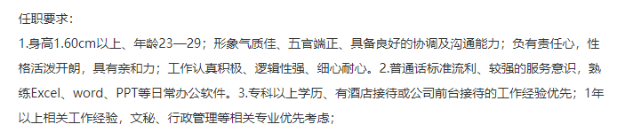


Case Study 1
Appearance discriminated: Stature above 160cm with nice appearance
Age discriminated: 23-29
Gender discriminated: Prefer Male
Education discriminated: 211/985 universities

Slide 39
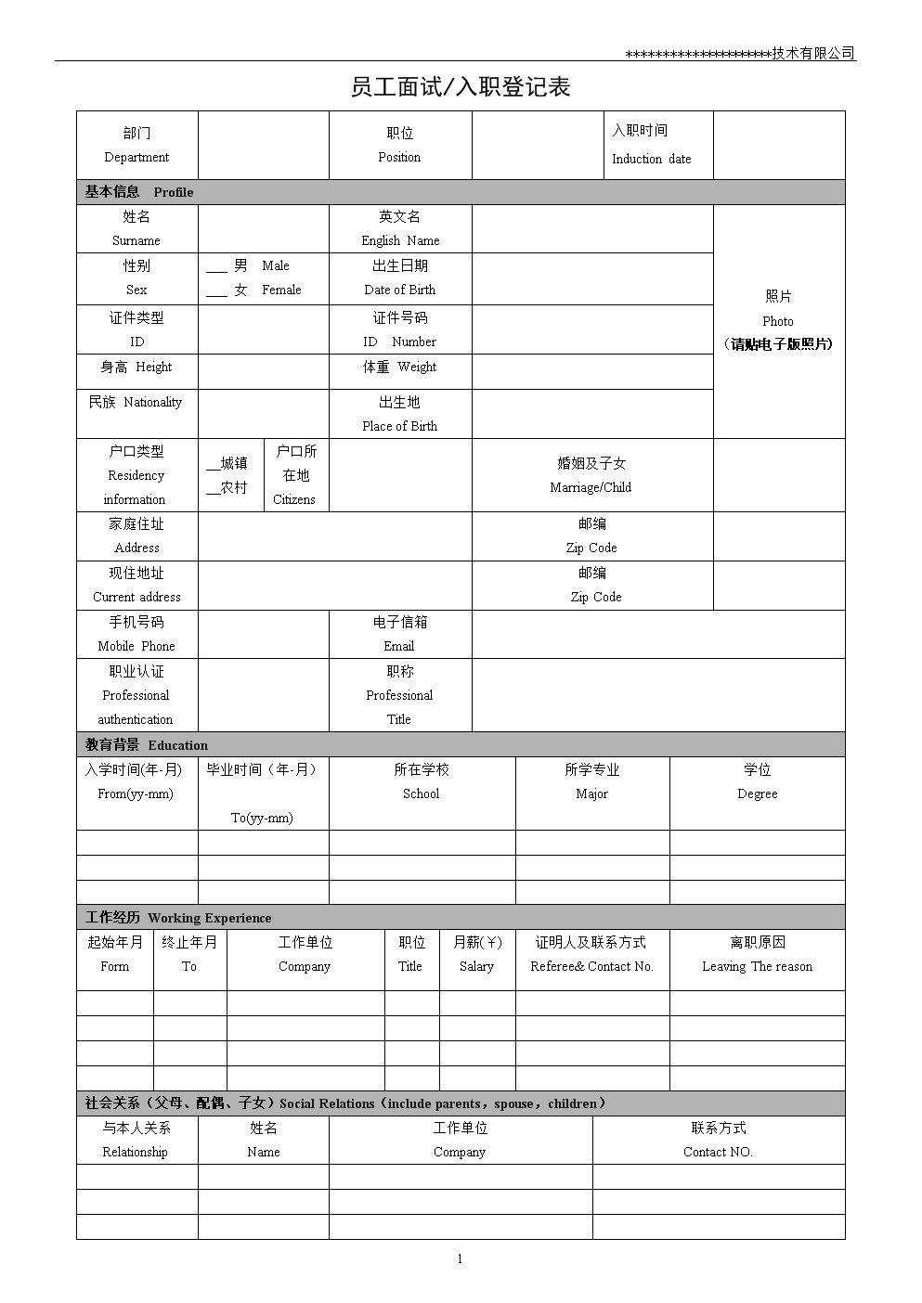
Case Study 2
Interviewee Information Collection form
Height & Weight
Maternity Status
Family Status
Family member: name
Family member: work in which company / organization
Family member: contact method

Slide 40
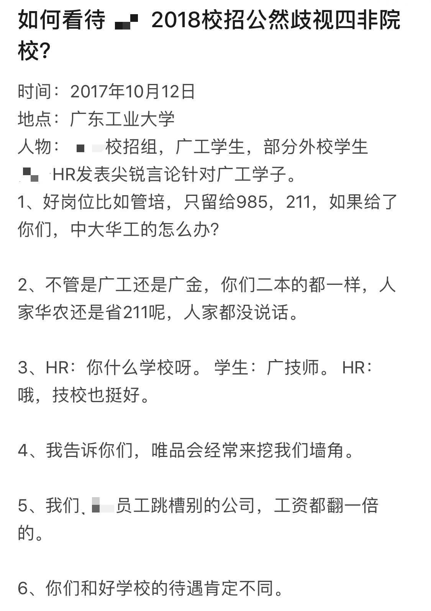
Case Study 3
XX Company’s Campus Recruitment
On 12th October 2017
The person in charge of XX Company Campus Recruitment saying that
  “We only need graduates from 211/985 universities to be our Management Trainees”
  “If students from 2nd tire universities became the management trainees, what about students from 985/211 universities?”
  “2nd tire universities are the same, even if the students join Suning, their positioning will be different from 985/211 students”
This caused a great sensation on the internet
The person was dismissed by the company afterwards

Slide 41
How to Avoid these Risks?
Do not include discriminated information in the job ads, to avoid risks as well as show respect to all candidates
Recruiting Requirement
Design comprehensive employment criteria and make sure the employee acknowledgement at the very beginning
Employment Criteria
Ask what you could ask to check the candidate’s competence;
Do not include any questions about the sensitive information or private information which is not related to the work.
Rights to Know

Slide 42
How to Avoid these Risks?
Qualifications
& Eligibility Check
Examine the candidate qualification and eligibility comprehensively and carefully
Including the required content factor in the offer letter;
Set clear validation and withdraw conditions
Offer Letter
Carefully draft the labor contract and strictly follow the labor law for the signing procedure
Labor Contract Signing

Slide 43
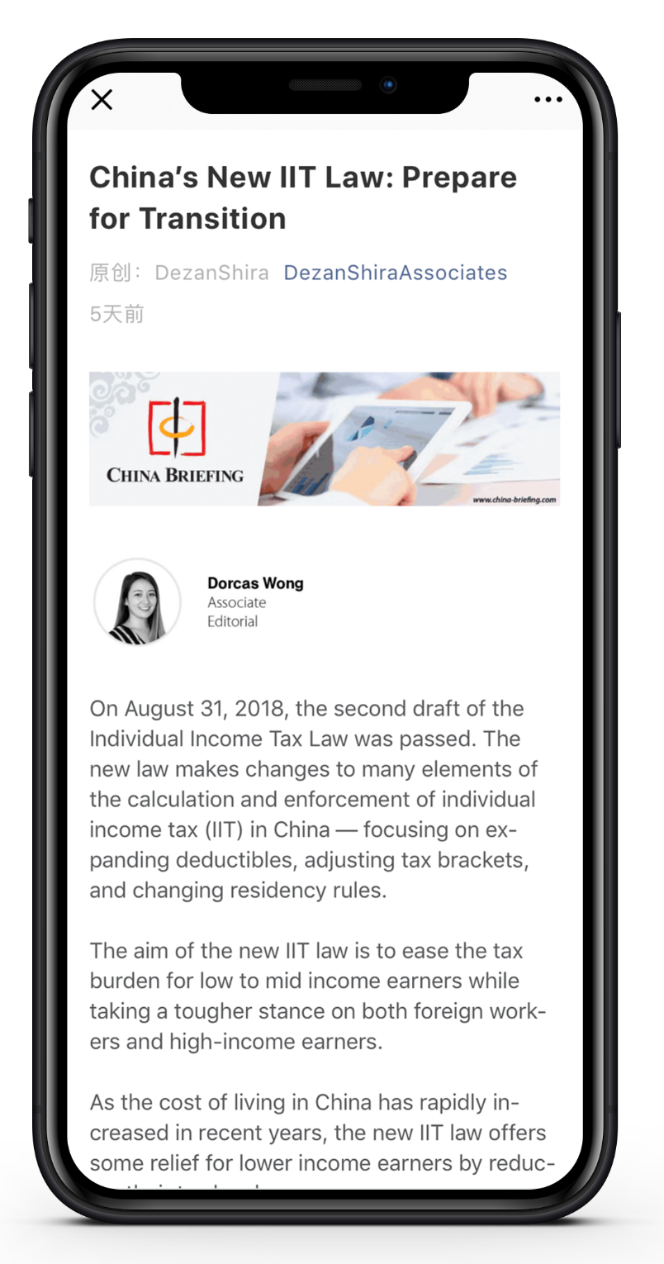



www.dezshira.com/library

