Slide 1
Table of Contents
Section 1:
What is HR Audit
Section 2:
Importance of HR Audit for Foreign Enterprise
Section 3:
HR Audit Procedure
Section 4:
HR Modules to be reviewed
Section 5:
Case Studies

Slide 2
What is HR Audit

Slide 3

What is HR Audit?
Like a finance audit, HR audit is an independent and objective evaluation of the current state of an organization’s HR policies, practices, documentation, and systems;
An HR audit can alert a company about hidden HR-related problems and errors, as well as possible compliance issues against a backdrop of China’s ever-evolving rules and regulations;
This can allow an organization to identify needs for improvement and establish best practices, thereby protecting it against possible operational and legal risk.

Slide 4
What is HR Audit?
Compliance
Employee Relationship Management
Whether the contract is signed in time or not;
HR Functions
Compensation management and C&B structures;
Social welfare payment – paid or not; paid in accordance with the correct contribution base/rate or not;
HR Strategy & Best Practice
Recruiting / selection / training / career development
Salary and overtime payments;
Working hours system and overtime management;
Leave and holidays;
Legitimacy of the contract clauses (e.g. probation period, termination, mandatory content, etc.)
Job description, job standards, job responsibilities;
Termination;
Payroll
Performance appraisals
HR supply and demand situation;
Appraisal of the effectiveness of the HR working process

Slide 5
Importance of HR Audit for Foreign Enterprise

Slide 6
Importance of HR Audit for Foreign Enterprise
Lack of know-how of the local practice
Due to the specialty and complexity of the Chinese labor law system, foreign enterprise may not possess enough know-how regarding Chinese labor law, related regulations and employee relationship management;
Hard to develop experts team in the early stages
In the earlier stages, it is unlike for foreign enterprises to develop not only comprehensive internal HR management system, but also acquire internal professionals in legal, tax, expat management;
Not objective enough if rely only on local HR team/in-house auditors
Sometimes, the local HR team or in-house auditors might be subjective and limited to interests conflicts / self-protections.

Slide 7
HR Audit Procedure

Slide 8
HR Audit Procedure – by stage
Stage 1: General Check
Overall check covering the certificate, policy, contract template, HR documents, etc.
Questionnaire & Checklist (primary)
Stage 2: One-by-One Check
In depth check of original documents, including labor contract, salary receipt, P-file, etc
Random Checking
On-site check/interview if needed
Stage 3: Historical Check
Termination Compliance
Payroll Compliance

Slide 9
HR Audit Procedure – by step
Plan and Design the Audit Approach
Understand corporate's business and industry;
Collect the Materials and Check
Company license and inspections
Confirm the audit target;
Decide the audit stages and methodologies;
Design Questionnaire and Checklist
Employment mode
Recruitment, Employee’s Enrollment & Separation
Employment contract management
Working hours & Employee leaves
Remuneration & Benefits
Confidentiality & Non-competition
Training & Service Period
Expat management
Staff Handbook template
1
2

Slide 10
HR Audit Procedure – by step
Perform Health Review
Review license & documents
Audit company policy, handbook, other legal terms
Check multiply reports, sampling individual case
Interview functional team member
On-site inspection when necessary
Issue Audit Report
Implementation Solutions
Facts statement
Potential risks
Suggestions & Solutions
Payroll compliance
Employee handbook revision
One-by-one check
3
4
5

Slide 11
HR Modules to be reviewed

Slide 12
10 HR Modules to be reviewed
Government
Employment Relationship
Compensation & Benefit
Employment Contract Management
Company license and certification
Employment Mode
Recruitment, Employee’s Enrollment & Separation
Working hours & Employee leaves
Expat Management
Remuneration & Benefits
HR Policy
Confidentiality & Non-competition
Training & Service Period
Staff Handbook

Slide 13

Company License and Certification
Company general introduction
  i.e. established date, industry, type of entity, etc.
History of the operations
  i.e. changes in the history, like M&A, Spin-Off, etc.
Current detailed organization charts
Business License
Companies’ social welfare accounts registration information
Typical Issues:
Lack of legal documents for the previous ‘Employee Transfer’ which might cause future labor disputes;
Did not apply for the ‘Flexible working hour certificate’ but ask the employees to work overtime without arrange alternative leave or pay OT subsidy;
Did not pay the Handicapped Fund for the last year, which is mandatory according to the local policy;

Slide 14
Employment Mode
A list of active employee demographic data
Category of Labor Relationship
  Full-time
  Part time
  Labor Dispatch
Typical Issues:
Do not have the employee name list and p-file tracking;
Incompliance labor dispatch ‘Percentage’;
Wrong contract signing of retired employees.

Slide 15
Employment Contract Management
Contract template
  Template review (mandatory clauses and other content)
  Sampling review of individual employees
Employee contract management policy and procedure
  Contract tracking
  Length of contract
  Contract renew and etc.
Typical Issues:
Did not include all nine (9) mandatory clauses in the labor contract;
Missing of important employee personal information;
Pitfalls in the Dispatched Service Agreement with the 3rd party agency.

Slide 16
Employment Contract Management
Employment Contract (Introduction)
Three Types of Employment Contracts
  Fixed term contract
  Non-fixed term contract
    After 2nd fixed term contract or 10 years of employment employee is legally entitled to an open term contract
    Not applicable to foreign employees who can only work on fixed-term contracts
  Labor contract which expires upon completion of certain agreed assignments
Timing of Employment Contract Signing
  Must be signed within one month of commencement of labor relationship
  Penalties
    Double salary from 2nd month to 12th month (or until contract is signed prior to 12th month)
    Open term contract after 12th month
Language
  Employment Contract should be in Chinese or bilingual (with Chinese included)

Slide 17
Employment Contract Management
Employment Contract (Content & Clauses in Article 17, Labor Contract Law of the PRC)
Mandatory Clauses
  Name and address of the employer and the legal representative or key person-in-charge of the employer;
  Name, address and identity card number or other valid identity document number of the worker;
  Term of labor contract;
  Job duties and work premises;
  Working hours and rest periods and off days;
  Labor remuneration;
  Social security;
  Labor protection, working conditions and occupational hazard prevention and protection;
  Any other matters to be included in a labor contract as stipulated by the laws and regulations.
Additional Optional Clauses
  Probation period
  Training
  Confidentiality
  Supplementary insurance
  Welfare and incentives
  Others

Slide 18
Employment Contract Management
Labor Contract Amendments
Salary Increase
  Theoretically, for all kinds of amendments of the labor contract content, the employer should sign an official agreement with the employees;
  Practically, as salary increase is a benefit for the employee, the employer may choose not to sign the agreement with the employee but instead of registering the changes on a internal form or sending a notice letter.
Salary Decrease
  To protect the company’s interest, we highly suggest the employer to sign an official agreement with the employee for any salary decrease decisions with mutual agreement with employee;
Job Transfer
  As change the job position is the change of the labor contract content, signing an official agreement to with employees to demonstrate the fact is also recommended;
Renewal of Employment Contract
  Company should ask the employee to sign the renewed Employment Contract.

Slide 19
Recruitment, Employee's Enrollment & Separation
Recruitment
  Recruitment Procedure
  Recruitment Channel, such as: head-hunting; advertising; E-recruitment
  Job Advertisement
Offer Decision
  Sample Offer Letter
  Offer Procedure
  Background check
Enrollment
  Health check notice and regulations for on-boarding
  Procedure of new employee on-boarding (required materials, paperwork, and signing standards;
Separation
  Employee exit policy and procedure
  Documents preparation & delivery
  Termination paperwork
Typical Issues:
Discriminated information in the job advertisement;
Incorrectly use of health check results;
Lack of necessary paperwork for departure employees.

Slide 20
Recruitment, Employee's Enrollment & Separation
Probation Period
Applicable Probation Periods
Employer’s Rights & Obligations
  The wage amount of a worker during his/her probationary period shall not be less than the lowest wage amount for the same job position in the employer's organization or 80% of the wage amount agreed in the labor contract and shall not be less than the minimum wage standard of the locality of the employer;
  Company can terminate employee during the probation period (with proof employee does not meet job requirements);
  The same employer (legal entity) and the same worker may only agree on probationary period once.
Employee’s Rights & Obligations
  Employee is entitled with the social insurance, housing fund and statutory annual leave during the probation period;
  Employee can resign by giving 3 days prior notice to employer.
Contract Term | Maximum Probation Period
Less than 3 months | None
3 months ~ less than 1 year | 1 month
1 year ~ less than 3 years | 2 months
≥ 3 years or non-fixed term contract | 6 months

Slide 21
Recruitment, Employee's Enrollment & Separation
Types of Permissible Termination
Termination Type | Admissible Grounds | Severance | 30 Days’ Notice
During probation | It is proven during the probationary period that the worker does not satisfy the employment criteria | No | No
Immediate | The worker has committed a serious breach of the employer's rules and system; The worker is guilty of serious dereliction of duties and corruption and causes the employer to suffer significant damages; The worker holds a labor relationship with another employer concurrently which has a severe impact on his/her performance of work tasks assigned by the employer or refuses to make correction as demanded by the employer; The labor contract is rendered void under the circumstances stipulated in item (1) of the first paragraph of Article 26; Criminal prosecution is instituted against the worker pursuant to the law. | No | No
With prior notice | The worker suffers from an illness or a non-work-related injury and is unable to undertake the original job duties or other job duties arranged by the employer following completion of the stipulated medical treatment period; The worker cannot perform her/his duties and remains to be incapable of performing the job duties after training or job transfer; The objective circumstances for which the conclusion of the labor contract is based upon have undergone significant changes and as a result thereof, the labor contract can no longer be performed and upon negotiation between the employer and the worker, both parties are unable to reach an agreement on variation of the contents of the labor contract. | Yes | Yes
Not renewing contract | End of contract term | Yes | No
Mass-layoff (over 10 people or 20% of staff) | The employer undergoes restructuring pursuant to the provisions of the Enterprise Bankruptcy Law; The employer has serious production and business difficulties; The enterprise undergoes a change of production, significant technological reform or change of mode of operation and upon variation of labor contracts, there is still a need for retrenchment; or The objective circumstances for which the conclusion of a labor contract is based upon have undergone significant changes and as a result thereof, the labor contract can no longer be performed. | Yes | Yes, to either all staff and/or the labor union. After hearing these parties, submit a report to the local Labor Bureau

Slide 22
Recruitment, Employee's Enrollment & Separation
Termination (Special Circumstances)
Under any of the following circumstances, the employer shall not rescind a labor contract pursuant to the provisions of Article 40 and Article 41:
  Where a worker who has engaged in work exposed to occupational hazards has not undergone post-employment occupational health check or during the period where a worker is suspected to have contracted an occupational illness or under medical observation;
  Where a worker has contracted an occupational illness or suffered a work injury while working for the employer and is confirmed to have lost his/her labor capability wholly or partially;
  During the stipulated medical treatment period of a worker suffering from illness or non-work-related injury;
  During the pregnancy, maternity leave or breastfeeding period of a female worker;
  Where a worker has worked for 15 years consecutively with the employer and will attain his/her statutory retirement age in less than five years' time; or
  Any other circumstances stipulated by the laws and regulations.

Slide 23
Recruitment, Employee's Enrollment & Separation
Severance Payment
Compensation Based
  Company required to pay one month’s average compensation (i.e. gross salary, annual bonus, other subsidies) for every year worked for company
    Average compensation will be calculated based on the average of the past 12 months
    If employee has worked 6 months or more in a year period, employee will be entitled to average month compensation
    If employee has worked less than 6 months in a year period, employee will be entitled ½ average month compensation
  Where the monthly wage of a worker is more than three times the local average monthly wage of employees of the preceding year announced by the Municipal People's Government of the centrally-administered municipality or the municipality divided into districts where the employer is located, the economic damages standard for economic damages to be made to the worker shall be based on three times of the average monthly wage and the years of service for which economic damages are paid for shall not exceed 12 years. (i.e. current Guangzhou economic compensation cap for calculation base is RMB 8,218 * 3 = RMB 24,654 )
Additional Considerations
  Company required to pay 2x daily salary for amount of days with untaken statutory annual leave

Slide 24
Working Hours & Employee Leaves
Working hour system
  Standard
  Non-fixed
  Flexible
Overtime (OT) management
  OT hours
  OT sample records
  OT payment / alternative leave management
Employee leaves
  Statutory annual leave
  Company paid annual leave
  Sick leave
  Unpaid leave
  Etc.
Absence management
  Leave application procedure
  Leave record management
Typical Issues:
Did not apply for the ‘Flexible working hour system’ but is applying it in daily work;
Obscure company policy: statutory annual leave & company paid annual leave;
Impractical leave application procedure;

Slide 25
Working Hours & Employee Leaves
Overtime (OT) Compensation
OT Defined Under Standard Work Hour System
  Work will be considered as overtime if company requests employee(s) to work during time in addition to 40 hours per week
  Employer must arrange alternative leave for employees or pay the OT compensation for employees extra working hours.
  The OT hours for one employee per month shall be no more than 36 hours.
OT Compensation Under Standard Work Hour System
Time of Work | Percentage of Hourly Salary
Extra Hours Worked on Weekdays | 150%
Hours Worked on Weekends | 200%
Hours Worked on Holidays | 300%
OT compensation calculation tips:
Based on the hourly salary of the employees
Daily salary: monthly salary ÷ 21.75
Hourly salary: monthly salary ÷ 21.75 ÷ 8

Slide 26
Expat Management
Work permit & Residence permit
Labor contract review
  Period
  Payment
  Differences with PRC employees which is important to know
Social welfares
  Enrollment
  Payment
  Claim & deregistration
IIT review
  Payment conditions
  IIT exemptions
Typical Issues:
Incorrect contract term with the expat employee – non-fixed term contract;
Some German employees do not need to pay the pension insurance; <Agreement between the People's Republic of China and the Federal Republic of Germany on Social Insurance>

Slide 27
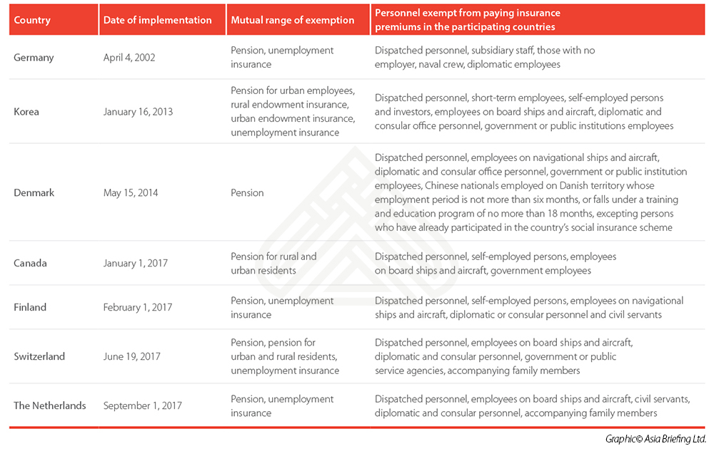
Expat Management
Social Welfare for Expat Employees
Expatriates who works in China are required to pay five different types of social insurances;
Housing fund is not required to be paid by expat employees.
Expatriates from several countries are eligible for exemption for paying social insurance in China due to the bilateral agreement
Source: http://www.china-briefing.com/news/2017/10/02/social-security-china-exemptions-foreigners.html

Slide 28
Remuneration & Benefits
Payroll report
  Salary structure
  Payroll format & standards
  Payroll calculations
Pay slip: procedure and template
Social Welfare
  Contribution base & rate
  Official payment record review & checking
Individual Income Tax (IIT)
  IIT calculation
  Official payment record review & checking
Typical Issues:
Payroll report calculation mistake & format improvements suggestions (e.g. logistics, formula, etc.)
Exceed the monthly OT ceiling required by the Chinese labor law;
The social insurance contribution rate & base do not compliance with the local regulations.

Slide 29
Remuneration & Benefits
Social Welfares
Pension
On the precondition that contributions have been made for at least 15 years, upon reaching retirement, an individual can receive a pension based on the accumulated in their individual fund.
Housing Fund
Designed to Ensure that workers save to purchase housing. Money from this fund can be used to pay the initial down-payment on a house. In most cases, a company determines the contribution rate (within the legal rate) when opening the housing fund account.
Medical
In the event of illness/injury an employee can have part of the treatment covered by insurance. Contributions accrue to a card that can be used for pharmacy or out-patient costs in government approved hospitals and clinics (excludes international clinics).
Maternity
For the period which an female employee suspend working due to breeding, the insurance provides with necessary material benefits including maternity subsidy, medical service and maternity leave, to support their recovery and return to the job position after giving birth.
Unemployment
In the event of redundancy (not in the event an employee chooses to resign), on the precondition that an employee has contributed to unemployment for at least 1 continuous year, employee may claim unemployment benefits for a maximum of 24 months.
Work-related Injury
Work-related injury fund covers the cost of treatment should an occupational injury occur. The employer must pay some salary during the period of rehabilitation and, if the employee cannot return to work, compensation must be paid.

Slide 30
Remuneration & Benefits
Social Insurance Incompliance (Penalties)
Enforceable Penalties (for failure to register/make correct contributions)
  Fine ranging from one to three times of the amount of the social insurance payable by the employer.
  Fine ranging from RMB 500 to RMB 3,000 by the person(s)-in-charge (e.g. GM, Legal Representative).
  Late payment interest calculated at 0.05% per day on the outstanding liability amount.
  Might raise the local bureau’s attentions towards the company and lead to other labor inspections on the company.
Penalty Collection
  If Company refuses to pay the social insurance and penalty on time, the labor bureau or the tax authorities shall apply for compulsory collection with the People’s Court.

Slide 31
Confidentiality & Non-competition
Confidentiality & Non-competition Agreement review:
  Content
  People
  Period
  Payment
  Penalty
Typical Issues:
Unilateral terms which has no legal validity in practice;
Did not choose the right group of employee’s while signing the agreements which lead to unnecessary costs.

Slide 32
Training & Service Period
Internal training policy review
Service period agreement review
  Training program
  Training period
  Training fee
  Service period
  Penalty
Typical Issues:
Invalid agreements - not all kinds of training the company could ask the employee to sign the service period agreement;
Unreasonable service period agreed in the agreement;

Slide 33
Staff Handbook
Basic factors to be included
  Company code of conduct
  All internal rules, guidelines and the rights of both parties
  Relevant Key Performance Indicators (KPIs), performance standards and assessment information
  Nondisclosure agreement
  Information about work environment
  Work hours and overtime rules
  Remuneration rules, social welfare rules, and bonuses
  Information about paid leave
  Behavior standards and discipline procedures
  Training information
  Workplace security rules
  Any other special rules relevant to the specific company/industry (i.e. manufacturing safety standards, hygienic food production standards)
Avoid including incompliance clauses
Democratic procedure
  Release the draft of handbook
  Seek employees’ opinions
  Official Announcement & publicly post
  Employees signing
Amendments of Staff Handbook
  Requiring Democratic Process
  Democratic Process will need to be repeated for amendment(s) to Staff Handbook, especially when said amendment(s) have a direct bearing on the immediate interests of employees, such as:
    Compensation
    Insurance and benefits
    Working hours, rest, or leave
    Work safety and hygiene
    Employee training and work discipline
  New hires
    Implementation of Democratic Process is not required for new employees joining company after Democratic Process has already been implemented
    New hire should review and sign copy of Staff Handbook
Typical Issues:
Did not go through the democratic procedure – make the handbook actually has no legal validity;
Invalid / incompliance content in the handbook;

Slide 34
Staff Handbook (Best Practices)
“Get the Most from Employee Handbook”
Link to Employment Contract
  Employment Contract should clearly reference Handbook (this will strengthen company’s case if needed to dismiss an employee over a breach of company rules)
Define Major and Minor Breaches
  Handbook should differentiate between minor and major breaches (allowing company the right to dismiss an employee without compensation)
    Major breach can result in immediate dismissal
    Minor breach, can result in an official warning letter and company will specify how many minor breaches may constitute a major breach
  Please note that decision whether a breach was sufficiently serious to warrant dismissal can be challenged in arbitration

Slide 35
Staff Handbook (Best Practices)
“Get the Most from Employee Handbook”
Language
  Have Staff Handbook written in Chinese; as well as, language of responsible management (e.g. English)
Moderate Length and Content
  Avoid writing Staff Handbook that is too lengthy
    May unnecessarily burden staff to stay in compliance and/or increases the workload of the HR department in supervising the rules
  Avoid subjective rules
    Company should be able to explain why each of the regulations is included
    If a dispute is taken to arbitration and company is found to have set subjective rules in order to find reasons to dismiss employees, the arbitrator is more likely to decide in the employee’s favor

Slide 36
Case Study

Slide 37
Case Study 1
Case Background:
A WOFE based in Dongguan with more than 400 employees; 90% of employees were factory workers.
This result was found when we reviewing their Staff Handbook.
  The company claims in the HR policy ‘012 Factory Confidentiality Agreement’ Part C that
  ‘All separation employees which due to contract termination, dismissing, resignation and retire, shall not be employed by another employer which engages in production or business in the same type of products or provision of the same type of service as the employer and shall not engage in own production or business in the same type of products or provision of the same type of service as the employer for 3 years’.
Audit Result:
Confusion about “Confidentiality Agreement ” and “Competition Restrictive Covenant”;
Exceeding lawful time period.
 | Confidentiality Agreement | Competition Restrictive Covenant
Aim | ‘not disclosing’ relative information of the company | ‘not doing’ relevant jobs
Applicable employees | Can apply to every employees | limited to the employer's senior management personnel, senior technical personnel and other personnel who are obliged to keep confidentiality
Time period | No limit | Should not exceed 2 years
Economic compensation | No | Yes

Slide 38
Case Study 2
Case Background:
This result was found when we reviewing one company’s OT policy & records.
  According to the payroll and phone communication with the local HRM, there are some fixed OT working hours for production workers, which is 3.5 hours per working day plus 8 hours for Saturday, totally calculated as 25.5 hours per week (102 hours per month). Some employees even work more than 102 hours such as XXX, who had 108 hours OT working in July.
Audit Result:
The OT hours are dramatically exceeding the upper limited defined in the Chinese labor law.
According to ‘Labor Law of the People's Republic of China’ Article 41,
‘The overtime worked shall in general not exceed 1 hour per day; in special circumstances where and extension of working hours is required, the overtime worked shall not exceed 3 hours per day under conditions which ensure the health of the workers, and the amount of overtime worked shall not exceed 36 hours per month’.

Slide 39
Case Study 3
Case Background:
This result was found when we reviewing one company’s departure case / process.
  Employer terminated an employee for disciplinary violations
  Employer did not state the termination ground (i.e., misconduct) in the termination notice; it only stated the termination date
  It did this because it did not want to negatively affect the employee’s employment prospects in case a prospective employer would have asked to see the termination notice
Audit Result:
Employee might reject the termination notice and filed a wrongful termination claim with the court:
Court might consider the termination was unlawful because the employer did not meet its burden to prove the unilateral termination was based on legal grounds; And also consider it significant that the employer did not follow the common practice of including a termination ground in the termination notice;
The court might order the employer to pay unlawful termination compensation to the employee;
Therefore - while there is no legal requirement to include a termination ground in the termination notice, courts may view its absence unfavorably to an employer.
A termination ground should be clearly stated in the unilateral termination notice, regardless of whether the employer is concerned about damaging an employee’s future employment prospects.

Slide 40
Risks During Hiring and Recruitment
Cherry Wu
HR Manager
29th March, 2019

Slide 41
Table of Contents
Section 1:
What are the Potential Risks?
Section 2:
Case Studies
Section 3:
How to Avoid and Prevent these Risks?

Slide 42
What are the Potential Risks?

Slide 43
What are the Potential Risks?
Lots of companies used to take it for granted that the recruitment procedure is easy to implement and it will contain no legal risks
‘It is just a simple matching game’
However, many common practices during the recruitment process are actually not appropriate or compliant with the labor laws, which will potentially bring risks to the company

Slide 44






What are the Potential Risks?
Recruiting Requirement
Employment Criteria
Right to Know
Qualifications
& Eligibility Check
Offer Letter
Labor Contract Signing

Slide 45
What are the Potential Risks?
1. Recruiting Requirements are Suspected of Discrimination
Gender
Nation/Race/Region
Religion
Education background
Appearance, etc.
2. Unclear Employment Criteria Causes Labor Issues
Difference between Recruiting Requirement & Employment Criteria;
Employee’s acknowledgement of the Employment Criteria
  <Labor Contract Law of the People's Republic of China>
  Article 39 Under any of the following circumstances, the employer may rescind the labor contract:
  (1) where it is proven during the probationary period that the worker does not satisfy the employment criteria;

Slide 46
What are the Potential Risks?
3. Risks Caused by Failure to Exercise the Right to Know
  Candidates:
  Job duties
  Working conditions
  Occupational hazards
  Work safety and health conditions
  Labor remuneration
  Employment criteria, etc.;
  Employer:
  Employee’s basic information
  Non-competition agreement status
  Occupational disease
  Any relatives in the company, etc.
Notes:
  The candidates do not have the obligations to tell above information on their own initiatives;
  Company can only collect basic info. related to check the job competence but not the private information.

Slide 47
What are the Potential Risks?
4. Risks of Loosely Qualifications & Eligibility Check
Dual employment
Non-competition Agreement arguments
Fake education background
Labor disputes specialized
Unclear leaving reasons from previous companies

Slide 48
What are the Potential Risks?
5. Risks of Less Rigorous Offer Letter
Basic factors
  Start date
  Work location
  Job position and Responsibilities
  Contract term and Probation details
  Remuneration information
  Working time, etc.
Legal validity
  Follow <Contract Law of the People‘s Republic of China> (Civil Law)
Withdrawn
  Without defining withdrawn conditions, the company might be facing the risks of unable to withdrawn the offer and must perform the duties to hire the employee
  Randomly withdrawn: violate the contract

Slide 49
What are the Potential Risks?
6. Risks during Labor Contract Signing Process
Risk of Labor Contract Content:
  Mandatory Clauses
    Name and address of the employer and the legal representative or key person-in-charge of the employer;
    Name, address and identity card number or other valid identity document number of the worker;
    Term of labor contract;
    Job duties and work premises;
    Working hours and rest periods and off days;
    Labor remuneration;
    Social security;
    Labor protection, working conditions and occupational hazard prevention and protection;
    Any other matters to be included in a labor contract as stipulated by the laws and regulations.
  Invalid Clauses
    In-compliance probation period;
    Unilateral exemption rules;
    Violation of related laws & regulations, etc.
Risk of Signing Procedure:
  Not signing written contract;
  Not signing on time;
  Not delivering the signed written contract to employee

Slide 50
Consideration of Re-hiring
Points to be noted
Reasons of leaving the company:
  Voluntarily / Involuntarily?
  Did the previous issues / problems being solved?
Probation period:
  The same employer and the same worker can only agree on probationary period once;
  In the case that the previous probation have not been finished, the probation shall resume after re-onboarding (exclude the middle period that the employee was not with the company);
  Annual Leave: accumulate or not & how to calculate?
  Service Month: accumulate or not & how to calculate?

Slide 51
Case Studies

Slide 52
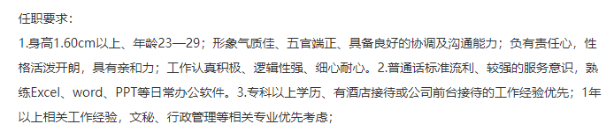


Case Study 1
Appearance discriminated: Stature above 160cm with nice appearance
Age discriminated: 23-29
Gender discriminated: Prefer Male
Education discriminated: 211/985 universities

Slide 53
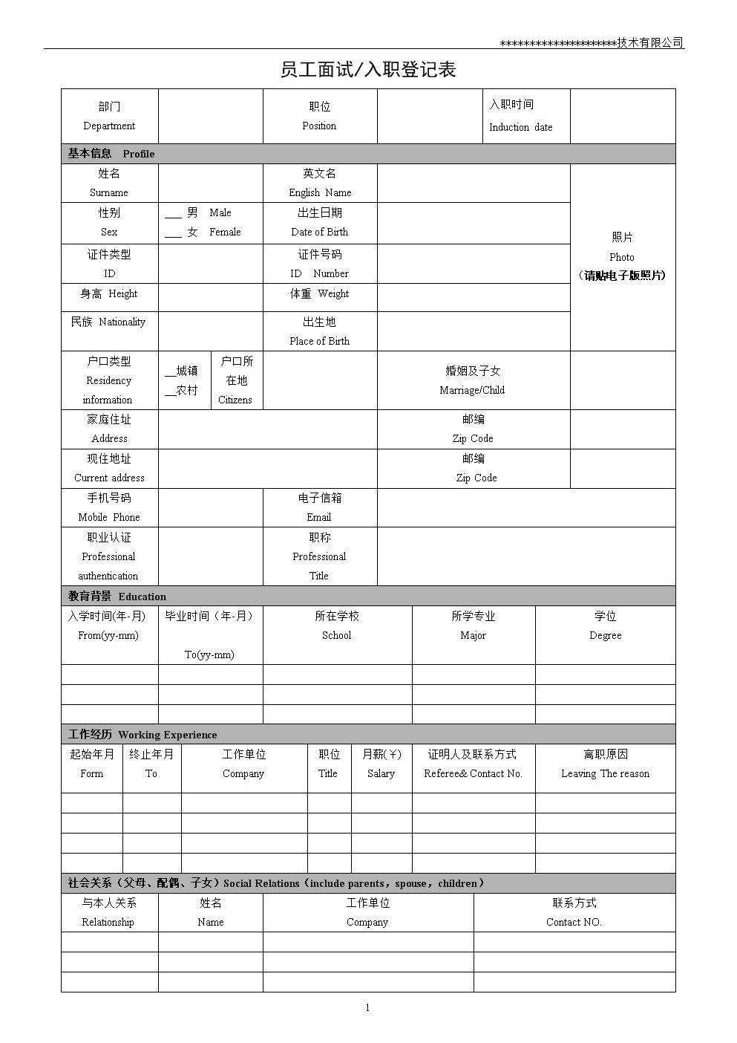
Case Study 2
Interviewee Information Collection form
Height & Weight
Maternity Status
Family Status
Family member: name
Family member: work in which company / organization
Family member: contact method

Slide 54
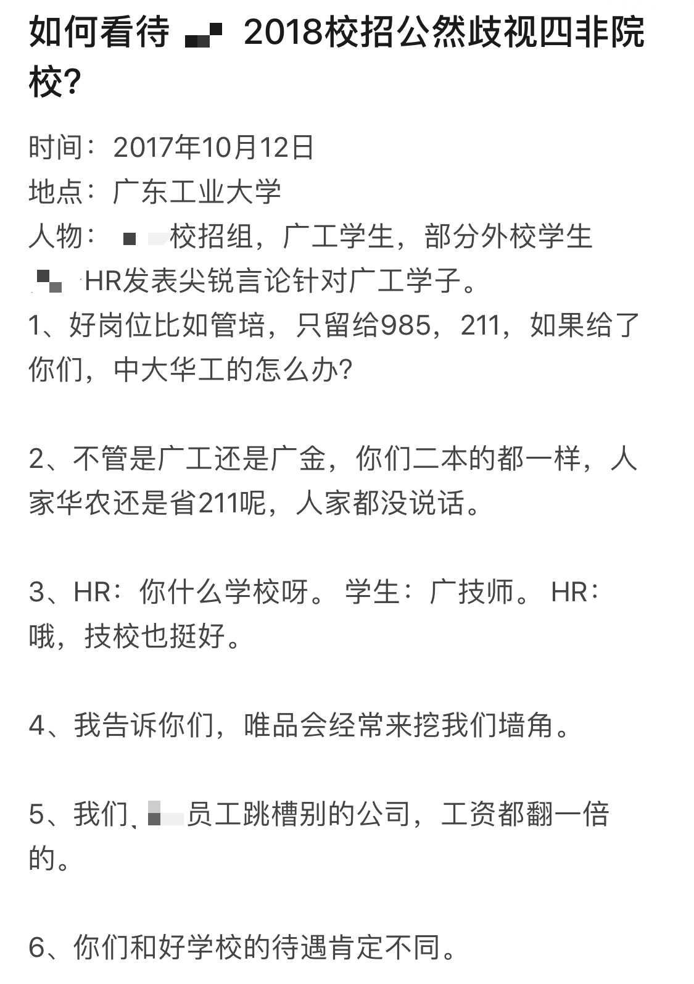
Case Study 3
XX Company’s Campus Recruitment
On 12th October 2017
The person in charge of XX Company Campus Recruitment saying that
  “We only need graduates from 211/985 universities to be our Management Trainees”
  “If students from 2nd tire universities became the management trainees, what about students from 985/211 universities?”
  “2nd tire universities are the same, even if the students join Suning, their positioning will be different from 985/211 students”
This caused a great sensation on the internet
The person was dismissed by the company afterwards

Slide 55
How to Avoid these Risks?

Slide 56
How to Avoid these Risks?
Do not include discriminated information in the job ads, to avoid risks as well as show respect to all candidates
Recruiting Requirement
Design comprehensive employment criteria and make sure the employee acknowledgement at the very beginning
Employment Criteria
Ask what you could ask to check the candidate’s competence;
Do not include any questions about the sensitive information or private information which is not related to the work.
Rights to Know

Slide 57
How to Avoid these Risks?
Qualifications
& Eligibility Check
Examine the candidate qualification and eligibility comprehensively and carefully
Including the required content factor in the offer letter;
Set clear validation and withdraw conditions
Offer Letter
Carefully draft the labor contract and strictly follow the labor law for the signing procedure
Labor Contract Signing

