Slide 1


title
Why Invest In Vietnam: Key Economic Priorities And Foreign Investment Policy

Slide 2

Table of Contents
title
Vietnam in 2019
Electricity Consumption
Policy Evolution
Foreign Participation

Slide 3
Vietnam in 2019
title
What is working? – Stability
*includes
Cambodia
Indonesia
Thailand
Philippines
Source: World Bank Governance Indicators

Slide 4
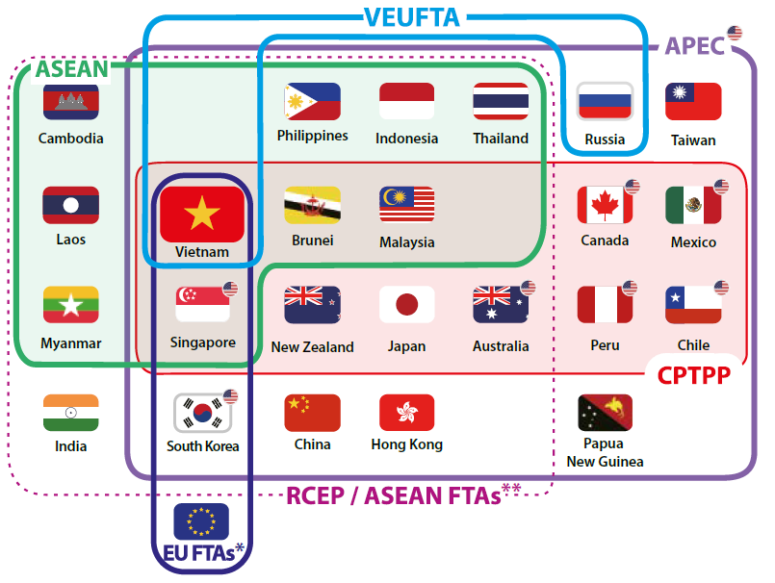
Vietnam in 2019
title
What is working? – Global Integration

Slide 5






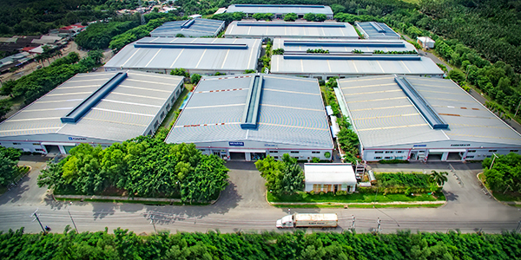
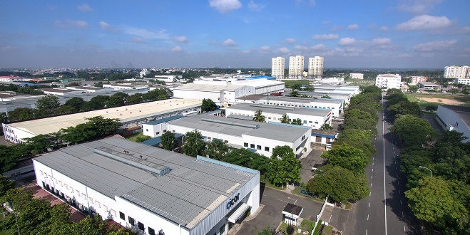
Vietnam in 2019
title
What is working? – Investment Support

Slide 6



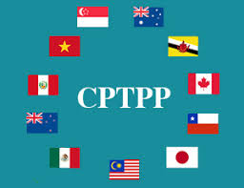

Vietnam in 2019
title
What is happening?
Recent Developments
Progression of historic trends
Future Drivers

Slide 7
Vietnam in 2019
title
What are the results?
FDI
Reached 19.1bn in 2018
FDI approvals in January hit US$1.9bn +51.9% (YoY)
Growth
Topped 7% in 2018
Projected to maintain annual rate of 5% through 2050
Consumption
Consumer spending rose 11% in 2018 (Jan-Nov)
+10% growth in spending projected through 2024

Slide 8
Electricity Consumption
title
Who is consuming energy?
Source: Vietnam Energy Outlook Report

Slide 9
Electricity Consumption
title
How well is electric generation keeping up?
Source: International Energy Agency; BP Statistical Review of World Energy 2018

Slide 10
Electricity Consumption
title
What does the future hold?
Electricity demand is projected to grow by and average of 8% annually until 2035
Source: Vietnam Energy Outlook Report

Slide 11
Energy Policy Evolution
title
Legislative Evolution
Electricity Legislation
Electricity Law 2004
Electricity Law Revised 2012
Decree 137/2013/ND-CP on Energy Law Implementation
Supporting Legislation
Law in Investment
Law on Enterprise
Decree No. 63/2018/ND-CP on PPP

Slide 12
Energy Policy Evolution
title
Non-Legislative Evolution
International Agreements
WTO
EU-Vietnam FTA
CPTPP
Policy Planning
Decision 1208 / QD-TTg of 2011
Decision 428 / QD-TTg of 2016

Slide 13
Foreign Participation
title
Current Market Opportunities
Market Player | Opportunity
State owned sector (EVN) | Seeking outside support to meet projected demand
Independent power producers (IPPs) | Expected to take on a larger role increasing competition
Privatization Generation Companies | Previously unavailable
Build – Operate – Transfer (BOT) Projects | Legislative framework is improving

Slide 14



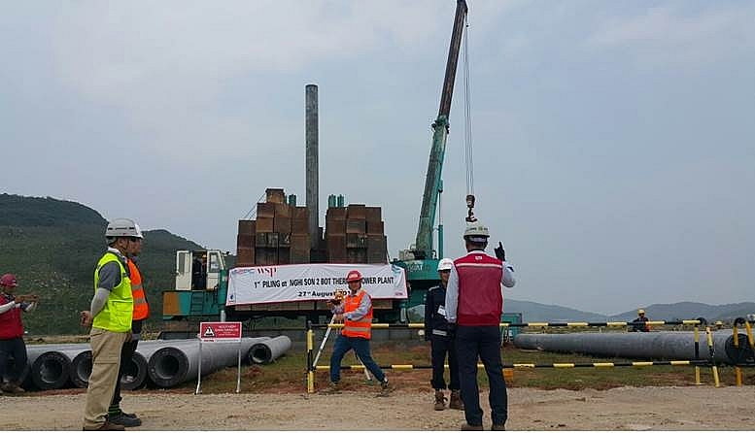

Foreign Participation
title
Nghi Son 2 thermal power plant
Nghi Son 2 thermal power plant is a $2.79 billion build-operate-transfer (BOT) project in Thanh Hoa which started construction August 27th 2018

