Slide 1
Leveraging Free Trade Agreements in Vietnam
An Introduction to Rules of Origin

Slide 2
Vietnam’s Positing in 2019
Trade Concepts
Rules of Origin
Tariff Reduction in Practice

Slide 3
Vietnam’s Positioning in 2019

Slide 4
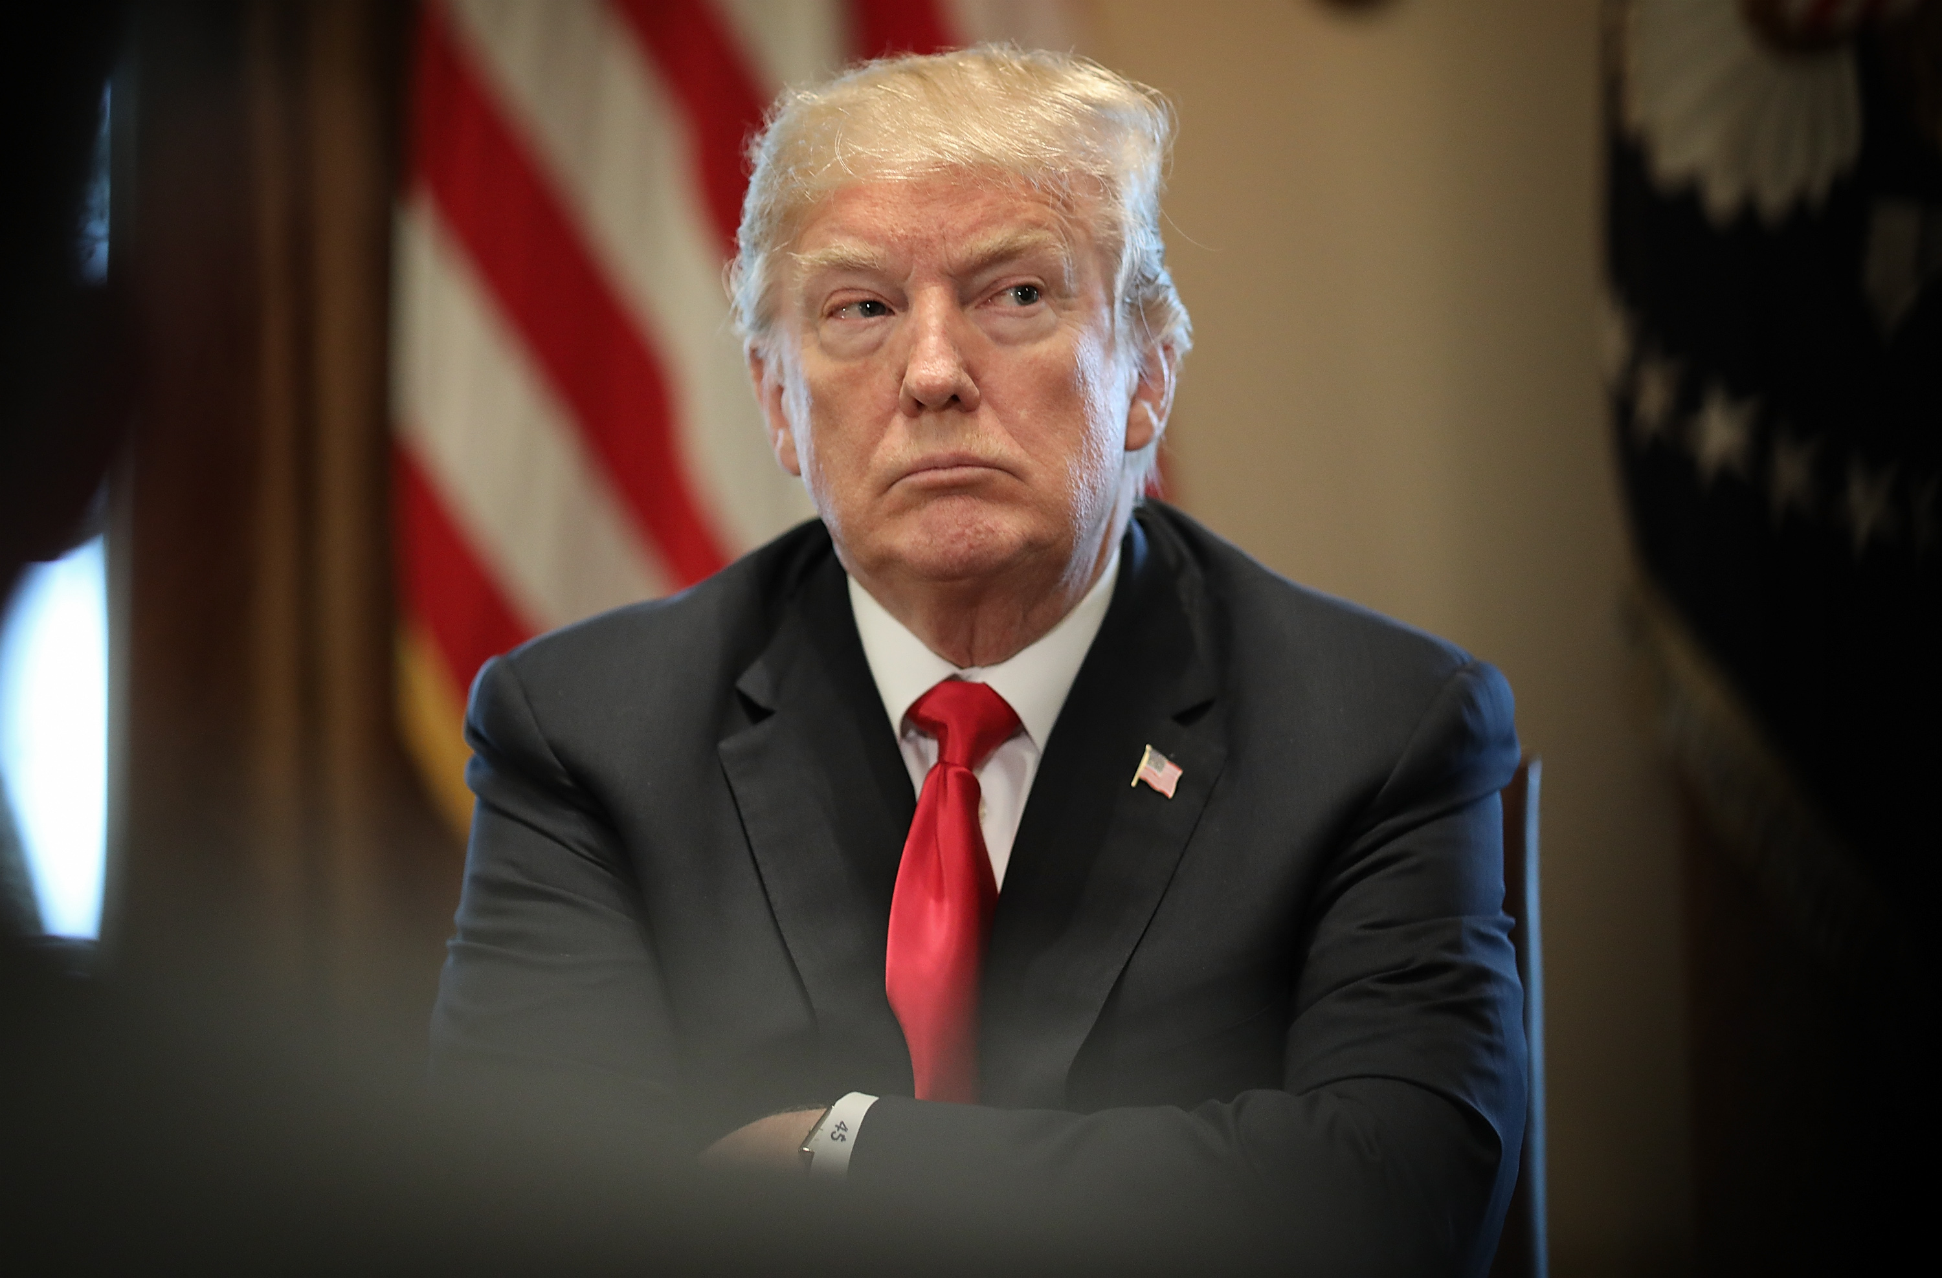
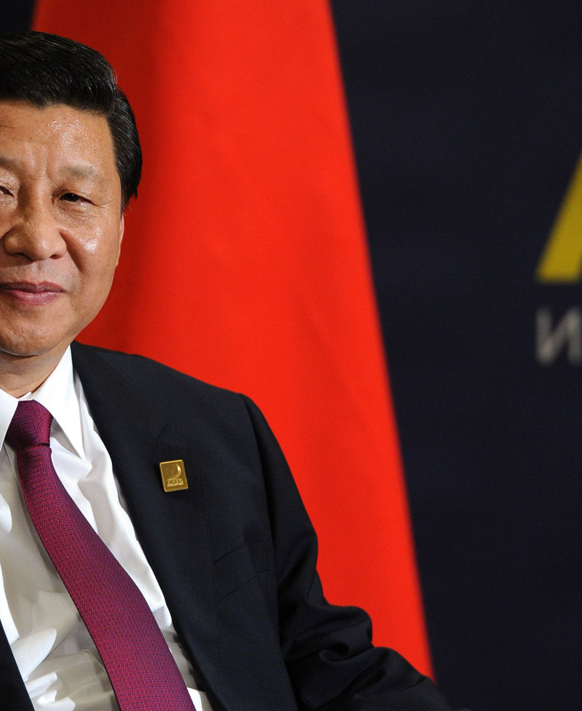
Background to the Trade War
Total US tariffs applied exclusively to Chinese goods
US$250 billion
Total Chinese tariffs applied exclusively to US goods
US$110 billion

Slide 5
Impacts on Trade and Investment in Vietnam
Performance As of June 2019
Exports to the United States (YoY Change)
Investment in Vietnam (YoY Growth)
New Projects +24.6% | Realized Capital Inflows +7.1%

Slide 6
Vietnam Compared to the Competition
Increasingly complex supply chain development
More complex assembly with growing local supply chains
Basic assembly
& textiles

Slide 7
Vietnam’s Competitive Advantage
Cost of Doing Business
Wages
Regulation
Compliance
Low Risk
Diversified International Relationships
Land
Cost to Quality Ratio
Industry Prioritization
Stable Government

Slide 8
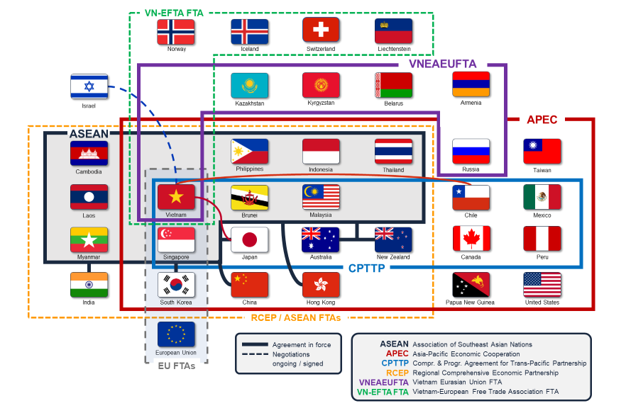
Vietnam’s Free Trade Agreement Network

Slide 9
Trade Concepts

Slide 10

Trade Concepts
Tariffs
Trade Agreements
Rules of Origin
HS Codes

Slide 11
Tariffs: An Introduction
MFN Tariffs
Applied in accordance with a country’s obligations to the WTO.
Applied evenly to all countries
Preferential Tariffs
Applied at a rate below a country’s obligations under the WTO.
Rates are subject to the terms of a specific FTA.
Countervailing Measures
Imposed by countries to fight unfair trade practices, such as national subsidies or dumping.
Normally applied on specific goods.
Tariff Type | Tariff Rate Example
Countervailing Duty | 79%
MFN | 5%
Preferential Tariff | 0
All tariffs are applied to individual products
Preferential tariffs and Countervailing measures are only applied to specific countries

Slide 12
Trade Agreements
Trade agreements act to reduce MFN tariffs between one or more countries. Current trade agreements can be enacted on a unilateral, bilateral, or multilateral basis
 | Unilateral | Bilateral | Multilateral
Parties | Single Country | Two Countries | Multiple Countries
Examples | GSP in the EU & USA | Vietnam Korea FTA EU – Vietnam FTA* | CPTPP
Change subject to | National approval | Negotiation | Negotiation
Pro | No negotiation required | Faster to conclude | Can import from multiple markets
Cons | Will be taken away by design | Smaller market access | Take longer to conclude

Slide 13










Trade Integration Compared
 | Average MFN Tariff Applied | China | Vietnam | Cambodia | Indonesia | India
USA | 3.44 | N + Trade War | N | GSP | GSP | N
Hong Kong | 0 | Y | S | S | S | S
Japan | 3.98 | N | Y | Y | Y | Y
Korea | 13.72 | Y | Y | Y | Y | Y
EU | 5.08 | N | S | ABA | GSP | GSP
India | 13.79 | N | Y | Y | Y | N/A
ASEAN | Variable | Y | Y | Y | Y | Y
Russia | 6.74 | S | Y | N | N | N
Australia | 2.5 | Y | Y | Y | Y | Y
Mexico | 6.91 | N | Y | N | N | N
S: Signed N: No Y: Yes ABA/GSP: unilateral trade concessions

Slide 14
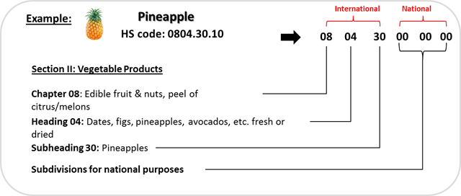
HS Codes: An Introduction
The Harmonized System (HS) classifies goods with a six-digit code system. The HS comprises approximately 5,300 article/product descriptions that appear as headings and subheadings, arranged in 99 chapters.
National Classification of Pineapple in the USA
HS Code | Description
0804.30.20 | In bulk
0804.30.40 | In crates or other packages
0804.30.60 | Reduced in size

Slide 15
Tariff Reduction Options
Tariff Type | How To Reduce | Which Rules Do I Follow To Prove Where My Product Originates?
Countervailing | Prove my product “originates” in a country that is not subject to countervailing measures | National rules of origin Rules of origin in an FTA
MFN | Prove that my product “originates” in a country that is eligible for preferential tariffs | Rules of origin outlined in an FTA
Preferential | ☺

Slide 16
Rules of Origin

Slide 17
What are Rules of Origin?
“Rules of origin are the criteria needed to determine the national source of a product.”
- WTO
Which Laws Will Apply to My Products?
National Rules of Origin
Applied by customs authorities in the absence of a preferential trade agreement
Rules are based on national customs guidelines
Preferential Rules of Origin
Applied by customs authorities when a free trade agreement is in place
Rules are based on the text of the free trade agreement.

Slide 18
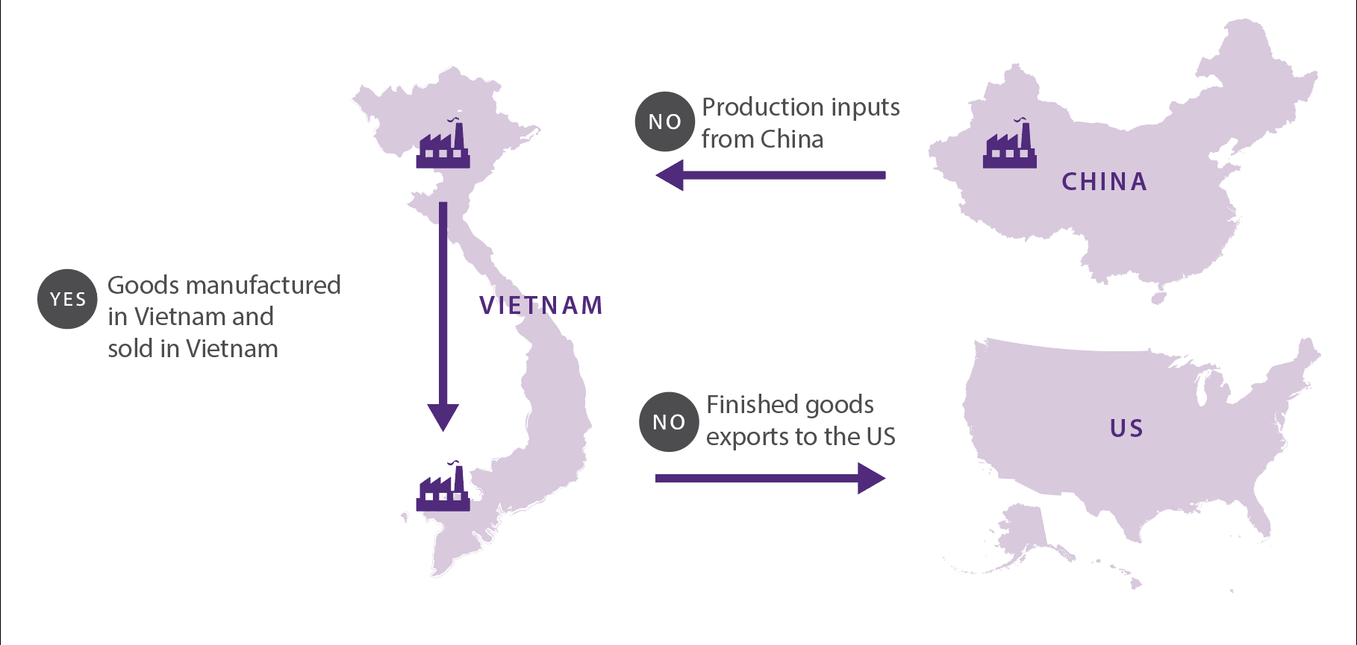
Mapping Rules of Origin Requirements
ASEAN / China
FTA
Domestic Legislation
in
Vietnam
US Customs Legislation

Slide 19
Classification of Goods
Products or inputs are commonly viewed by customs as one of the following:
Wholly obtained
Products that are entirely produced from a specific country
Example: coffee grown in Vietnam
Non-wholly obtained
A product with components from multiple countries that has undergone “sufficient working” in one country to be considered originating
Example: Cell phone assembled in Vietnam with components from Malaysia, Korea, and China
Non – Originating
Products or material that are sourced from third party markets
Example:
1. Goods shipped through Vietnam
2. Goods that undergo minimal processing in Vietnam (cleaning, packaging, ect).

Slide 20
Types of Guidelines Used to Determine Product Origin
Rules of Origin
Process based requirements
Value based requirements

Slide 21
How to Confer “Originating Status” to Non-Wholly Obtained Products
(Process Based Origin Requirements)
Term | Definition | Example:
CC (Change in Chapter*) | Originating status is conferred to a finished product that is classified in a different chapter than all non-originating inputs | Export 8441.90 Qualifying input: 8341.90 Insufficient input: 8431.20
CTH (Change in heading*) | The originating status is conferred to a good that is classified in a different HS heading than the non-originating inputs. | Export: 8441.90 Qualifying input:8442.90 Insufficient Input:8441.92
CTSH (Change in subheading**) | The originating status is conferred to a good that is classified in a different HS subheading than the non-originating inputs. | Export: 8441.90 Qualifying Input: 8441.9100 Insufficient input: 8441.9012
*Chapter refers to the 02 digit product code **Headings refers to the 04 digit product code **Subheading refers to the 06 digit product code

Slide 22
How to Confer Originating Status to Non-Wholly Obtained Products
(Regional Value Content Origin Requirements)
Term | Definition | Example:
RVC (Regional value content) | A good obtains originating status if a defined regional value content percentage has been reached. | RVC = 30% Qualify: 30% of product’s value = VN Insufficient: 29% of product’s value = VN
Note: the regional value content required and method for calculating value depends on the laws applied & product in question.

Slide 23
CHINA +1
Tariff Reduction in Practice

Slide 24
What level of processing will be sufficient to change products to “Made in Vietnam”
 | Type of Operation | Activities in China | Activities in 3rd party market | Location of suppliers | Ability to change origin of good away from China
1 | China | Manufacturing & Assembly | N.A. | China | 0%
2 | China +1 | Manufacturing & Assembly | Finishing & Packaging | China | Very Low
3 | China +1 | Manufacturing | Simple Assembly | China | Low
4 | China +1 | Manufacturing | Manufacturing + Assembly | China + 3rd party market | Medium
5 | Full Relocation | N.A. | Manufacturing + Assembly | China + 3rd party market | High
6 | Full Relocation | N.A. | Manufacturing + Assembly | 3rd party markets | 100%

Slide 25

Case Study Overview
Company Profile
Issues
US based company
Company only makes Door Knobs
Company has warehouses in the United States that will help them mitigate tariffs in the near term
Company does not export to any market other than the United States
Company does not wish to outsource its manufacturing to a third party
Company has heard about the trade war and its potential impact on their operations. With this in mind, they would like to understand the following:
Their current and future exposure to US Tariffs
Available options to retain operations within China
Alternative markets to shift production with an emphasis on their tariff exposure
Products
Brass Door Knobs
Door Knobs are manufactured from copper billets

Slide 26
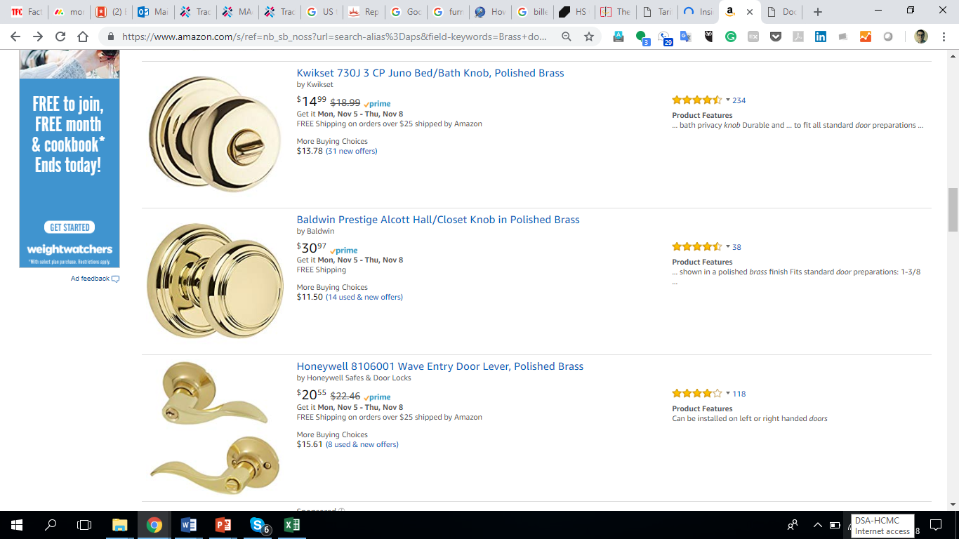
Historical Exposure of Door Knobs to Tariffs
Past and Current
Current Pricing on Amazon
Potential Impact on Pricing
MFN
US$14.99
+10%
US$16.48
+25%
US$18.73
Note
5.10.2019
Despite being in effect, tariffs are unlikely to result in price changes until company stockpiles are depleted. Many companies boosted imports to avoid paying taxes.
The cost to manufacture an individual door handle is in reality much lower than prices that are posted on Amazon.
27

Slide 27



Tariff Reclassification of Door Knobs
Current US tariffs do NOT leave room for reclassification. All related HS codes shown below are also subject to US tariffs:
Neighboring HS Codes
Integration with More Complex Products
All HS codes close to companies HS code of HS 8302.41 are subject to US tariffs.
8302.10.60, 8302.10.90
8302.20.00, 8302.30.30
8302.30.60, 8302.41.30
8302.41.60, 8302.41.90
8302.49.20, 8302.49.40
Products that make use of company’s product, such as doors or drawers, are also subject to US tariffs.
US
Tariffs
www.dezshira.com
28

Slide 28
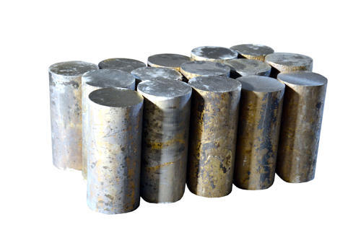
HS Code Classification for Door Knobs & Associated Inputs
Door Knob Inputs
Copper billets are the main input for door knobs. These are classified under HS 7403.13
Note: Design services carried out in China are unlikely to impact the good’s origin
Final Product
Finished door knobs are commonly exported under HS code 8302.41

Slide 29





The Door Knob Manufacturing Process
Design
Raw Material Sourcing
Forging
Surface Preparation
Coating
Export

Slide 30
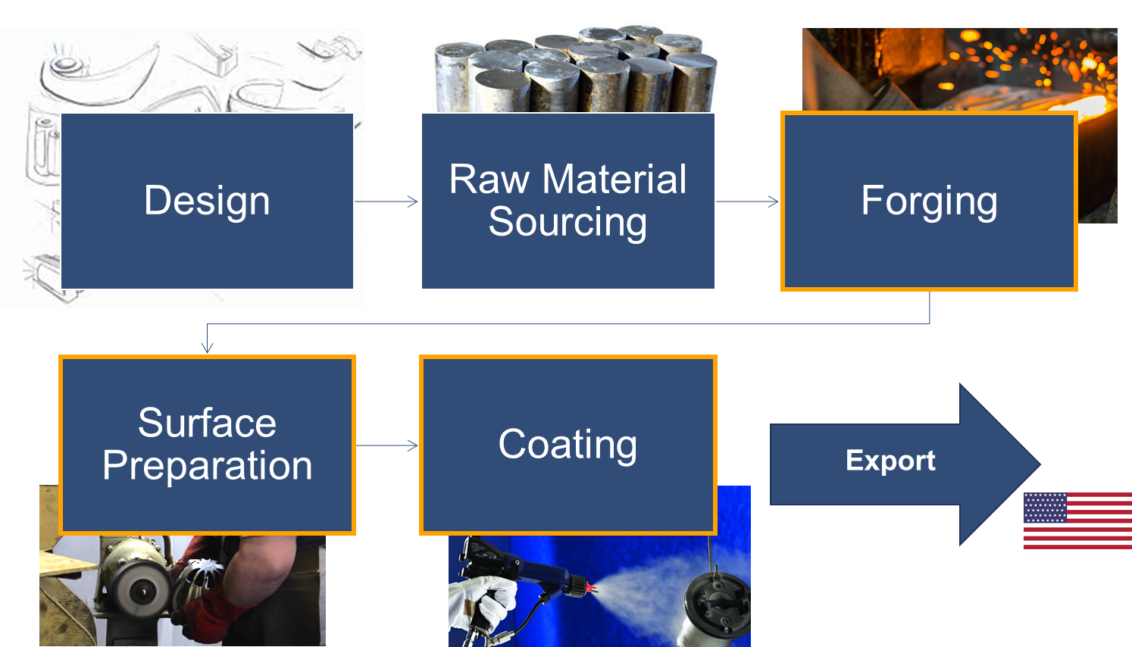
Achieving “Made in Vietnam”
GSP
Changes are required for Vietnamese goods
What will Company be required to relocate?
Prevailing customs legislation in the United states requires to the following to confer originating status to company’s product (8302.41):
  A change to subheading 8302.10 through 8302.60 from any other subheading, including another subheading within that group.
Current HS classifications do not make a distinction between Door Knobs that are molded and those that have been finished – through the surface preparation and coating.
Furthermore, prevailing US customs legislation does not confer originating status based on the value added in a third party.
Inputs brought from China cannot be classified as 8302.41
At minimum, inputs must change the last 02 digits during processing.
8302.40, for example, would be permitted.
www.dezshira.com
31
31

Slide 31




Relocation of Door Knob Manufacturing
1
2
3
ACFTA
GSP
MFN
Proposed Operational Structure
4
1. Design & Raw Material Sourcing + any other processed
2. Ship copper billets to third party
3. Undertake forging, surface prep, and coating in third party market.
4. Ship finished door knobs to the United States
www.dezshira.com
32

Slide 32
Assessing Exposure of Inputs (Billets) to Tariffs
Copper Billets
ACFTA
HS 7403.13
Importing country | Tariff regime | Total ad valorem equivalent tariff
Cambodia | ACFTA | 0%
India | MFN | 5.00%
Indonesia | ACFTA | 0%
Philippines | ACFTA | 0%
Thailand | ACFTA | 0%
Viet Nam | ACFTA | 0%
ACFTA
ACFTA removes tariffs on billets being shipped from China to all ASEAN markets.
Companies will need to comply with rules of origin requirements to qualify for tariff exemption
China to India
China and India’s bilateral and multilateral tariff concessions do NOT remove all tariffs.
www.dezshira.com
33

Slide 33
Assessing Exposure of Door Knobs to US Tariffs
Door Knobs
GSP
HS 8302.41
Exporting country | Tariff regime | Applied tariff (as reported)
Cambodia | MFN duties (Applied) | 3.50%
 | Preferential tariff for GSP countries | 0%
India | MFN duties (Applied) | 3.50%
 | Preferential tariff for GSP countries | 0%
Indonesia | MFN duties (Applied) | 3.50%
 | Preferential tariff for GSP countries | 0%
Philippines | MFN duties (Applied) | 3.50%
 | Preferential tariff for GSP countries | 0%
Thailand | MFN duties (Applied) | 3.50%
 | Preferential tariff for GSP countries | 0%
Viet Nam | MFN duties (Applied) | 3.50%
US GSP
All counties will provide significant tariff relief compared to tariffs currently applied to Chinese exports.
US GSP provides tariff reductions for developing countries. Many countries assessed will qualify for US GSP.
What about Vietnam?
Vietnam and China are both ineligible for US GSP because of a cold war era line in GSP which disqualifies communist countries from receiving assistance.
www.dezshira.com
34

Slide 34
Treatment of Vietnamese Goods
Lowest Tariff Exposure
Additional Considerations (Beyond Tariff Analysis)
GSP
Country | Input Import liability | Export Liabilities
China | 0% | 25%
Cambodia | 0% | 0%
India | 5.0% | 3.5%
Indonesia | 0% | 0%
Philippines | 0% | 0%
Malaysia | 0% | 0%
Myanmar | 0% | 0%
Thailand | 0% | 0%
Viet Nam | 0% | 3.5%
Labor
Domestic taxation
Logistics
Business Environment
Trade Connectivity
Domestic Suppliers
Infrastructure
www.dezshira.com
35
35

Slide 35
How We Support

Slide 36
Treatment of Vietnamese Goods
GSP
Phase 1
Tariff & Rules of Origin Analysis
What will be required to avoid 25% tariffs?
How much taxes will I actually pay when exporting to the US & importing from China?
Phase 2
Rules of Origin Advisory
How can I ensure my assembly meets requirements outlined in Phase 1?
Phase 3
Cost & Feasibility Comparison
Which country can support my investment?
Which countries are realistic options to achieve compliance?
www.dezshira.com
37
37

