Slide 1

Retention Strategy Under Total Compensation
Prepared for European Chamber
Ellen Yin
Sep 2019

Slide 2








DSA Service Suite
  Pre-Investment and Entry Strategy Advisory
  Accounting, Payroll, and Treasury
  Corporate and Tax Structuring
  Tax and Compliance
  Cross-border Transactional Support
  Employment law and HR
  Audit Financial Review, Due Diligence
  ERP and Financial System Advisory

Slide 4
Table of Contents
01 The hidden reasons employees leave
Why should care about employees leaving
Pull & Push leaving reason
02 Total compensation
What’s the total compensation
How to optimize total compensation for employees
03 Retention strategy
Action recognition
Psychological contract

Slide 5
Section 1
The hidden reasons employees leaves

Slide 6

Why should care about employees leaving?
Common mentality of mangers who don’t care
HR easy to find the replacement
Too busy to think why they left
Do the job or be fired
The earth still going around
without you
They are trouble employees
We just pay too low

Slide 7
Why should care about employees leaving?
Working-age (16-59) population in China (Millions)
Aging Rate in Cities
Aging people in China
Working-age people is downsizing while the aging people is rising
Estimate starting year of 2025, aging people will over 300 million in China and become a super-aged country
Data source: the state statistics bureau and websites

Slide 8
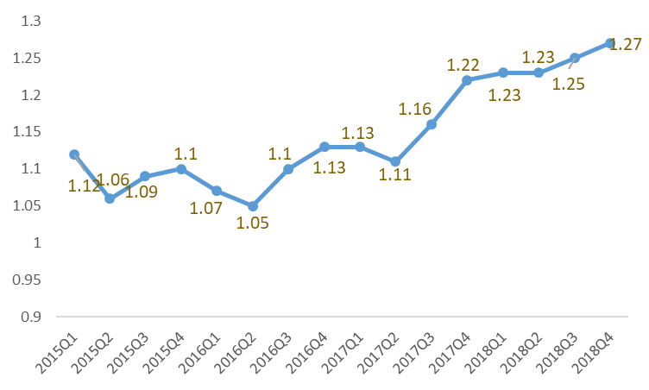
Why should care about employees leaving?
The war for talents
Ratio of openings job to applicants 2015-2018
2017 Q2 Talents demand vs supply in different industry
Regional polices for attracting talents
Leaving rate in different kinds of positions
Shanghai: preferential policy to Hukou application for talents etc.
Greater Bay Area (GD-HK-Macao)
Nanjing: preferential policy to Hukou application and housing allowance
Tianjing, Hangzhou…
Data source: 1.PRC HR market information monitoring center; 2. Report from Liepin; 3. Report from 51job

Slide 9

Why should care about employees leaving?
True cost that could be avoided
The cost of losing an employee is much higher than most mangers’ expectation.
In average, the loss to a company of an employee leaving is around this employee’s annual salary*.
Visible Cost
Higher compensation & benefit may cost for the replacement
Recruiting cost
Training cost
Invisible Cost
Severance Pay
Low efficiency
Loss in the vacancy period
* A study released by the Saratoga Institute and published by the American Management Association

Slide 10
Pull & Push Leaving Reason
Mental process of employee leaving
Phase I
Be enthusiastic about job
Phase II
Doubt the decision of accepting the job
Phase III
Count the cost
Phase IV
Ready for looking new job
Phase V
Get the new offer or not
Decide to leave
Seeing new companies
Leaving with the offer or not
Or stay but slack off
35% of participant in a survey of “leaving decision” take 6-12 months from the idea formed to truly left, 15% take 1-2 years
And, 77% looking for new opportunity during the employment; 66% believe if company had done some changes, would change their leaving decision
Data source: leaving decision survey, 2004-2012, www.keepingthepeople.com

Slide 11
Pull & Push Leaving Reason
Data source: leaving decision survey, 2004-2012, www.keepingthepeople.com

Slide 12
Pull & Push Leaving Reason
What’s the data reflect
Company impact on employees leaving decision
Except some leaving reasons that can’t be avoided, the leaving reason can be concluded to there are four needs that have not been satisfied – “not be expected”, “not be trusted”, “not be valued”, “not be cared”
There are a long period when coming up the idea of leaving to take the action. If company do some positive changes before “the last straw” can prevent or stop employees leaving effectively
There are some leaving reasons that company can’t avoid, such as: retire, moving to a new house, family issues, career change, further education etc., but these reasons only around 5% of all leaving reasons
The “push” are the main cause employees leaving
High
Low
Voluntary leaving
Voluntary leaving
Employees leave willing
High
If company make some changes, can prevent/stop employees be leaving (95%)
Even company do something still can’t effectively change the situation
e.g. unfair treatment, communication …
e.g. self-employed, further education…
Involuntary leaving
Voluntary leaving
Process
流程
Low
Company decide terminate the labor relationship with employee
Employee and company both can not change the situation
e.g. serious violation of regulations & rules …
e.g. relocation, family issues…

Slide 13
Section 2
Total compensation
-How to optimize total compensation for talents

Slide 14
Total compensation
What’s the total compensation
Total compensation relevance theories
The leaving reasons indicate
Maslow’s hierarchy of needs
Physiological needs
Safety needs
Love and belonging
Esteem
Self-actualization
Equity theory
Op/Ip=Oa/la
OP/IP=OH/IH
Expectancy theory
Motivation= Valence * Expectancy
Two factory theory
Satisfaction - No satisfaction
Dissatisfaction - No dissatisfaction
Not be expected
Not be trusted
Not be valued
Not be cared

Slide 15
Total compensation
What’s the total compensation
Total Compensation Model
Enterprise Culture
Compensation
Benefits
Work-Life balance
Performance and recognition
Development and Career opportunities
Employee
Business
Corporation
Strategy
Attraction
Motivation
Retention
Engagement
&
Satisfaction
Business
Growth /
Excellence
HR Strategy
Total compensation included compensation, benefits, work-life balance, performance and recognition, development and career opportunities.
Also, total compensation can be divided to external excitation and internal excitation. External excitation including salary, bonus, stock equity, allowance, insurance. Internal excitation including whether employees willing to devote work fully, training for employee improvement, promotion mechanism, rewarded by company etc.

Slide 16
How to optimize total compensation for employees
Total compensation optional indicators

Slide 17

How to optimize total compensation for employees
Strategic orientation
Fairness principle
Compliance in company/business/HR strategy and enterprise culture
What’s the issue on TC system, what’s the goal for optimizing
Is total compensation only suit for key positions?
Questionnaire survey
Position analysis, evaluate position value, improve position description. E.g. International position evaluation (IPE), impact, communication, innovation, knowledge four aspects
Reward pinpoint
Benefits distribution
Total compensation optimizing
External competitiveness
Motivation principle
Talent market competition – find your strength of attracting talents
Salary benchmarking and set the internal pay policy line
Be agile
Agile goal setting, KPI/OKR (Objectives and Key Results), SMART
Job Ladder and salary width, salary variation
Improve internal excitation policy

Slide 18

How to optimize total compensation for employees
Review internal TC system
Questionnaire survey
Problem area analysis
Optimization TC system
Fixed Salary
Variable Salary
Benefits
Work-life balance
Performance and recognition
Development and career opportunities
Measure the importance of indicators
Measure the satisfaction about the TC system
Whether in compliance the strategy and company culture
Find the root causes
Do market survey
Improve the weakness part or deficient part
Do follow up survey after the new system/policy launched
Review internal TC system
Questionnaire survey
Problem area analysis
Optimization TC system
Notes:
if monthly wage capped at 300% of local average, working year must be capped at 12 years

Slide 19
Section 3
Retention strategy

Slide 20
Retention strategy
Action recognition
Positive feedback on employees’ work
Change behavior
Improve working relationship
Better working experience
Better leadership

Slide 21
Retention strategy
Psychological contract
Not be expected – know the expectation of company
Not be valued – know what will be provided by company
A written “psychological contract”
As employee, you have rights to expect company/ your supervisor to do the following:
A meaningful and challenging job
An open and constructive communication environment
…
Company/ your supervisor expect you to do the following:
Devote the work at your best to achieve success
Strong sense of responsibility to complete work task
…
What do employees want
What does company want to provide
What do employees expect to work for
What does company expect to get from employees

Slide 22






Publications Resources
China Briefing Guide:
Human Resources and Payroll in China 2019-2020
Asia Briefing, a subsidiary of Dezan Shira & Associates, publishes business magazines and guides for China, Vietnam, India, Singapore and other key nations in emerging Aisa.
Asiapedia is a collection of resources based on our practical experiences.
To learn more knowledge on doing business in Asia, Please visit: https://www.dezshira.com/library
For more business publications, Please visit Asia Briefing Bookstore: http://www.asiabriefing.com/store/

Slide 23

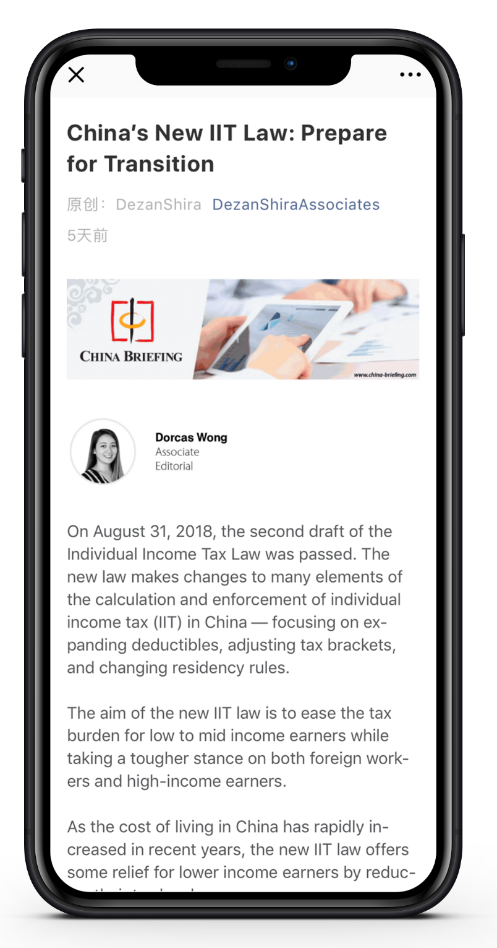

Slide 24
Ellen Yin
Email: Ellen.Yin@dezshira.com

